Slide 1
Linear Sources in The Random Ray Method
Rufus Neame rn438@cam.ac.uk

Slide 2
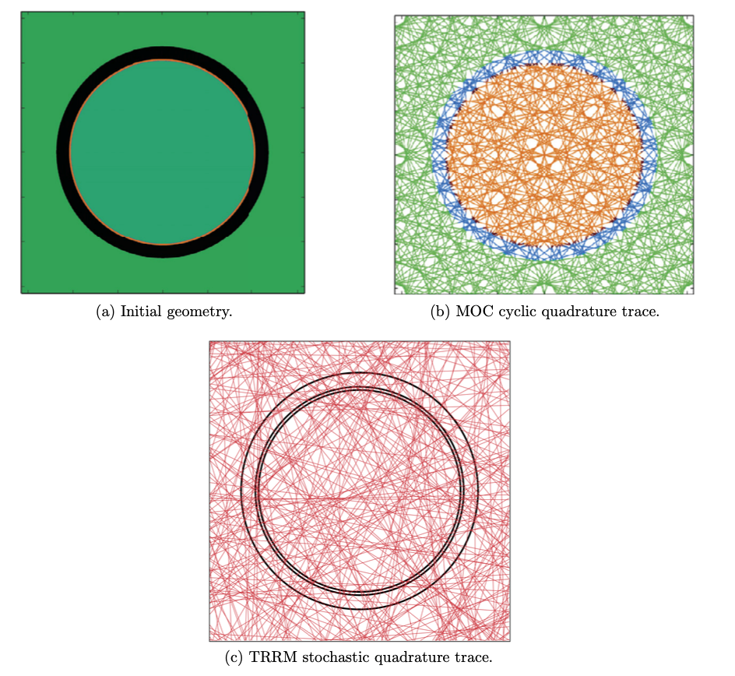
The Random Ray Method (TRRM)
Based upon Method of Characteristics (MOC).
Stochastic quadrature integration.
Randomly spaced and angled tracks.
Equal weighting for ray calculations.
Requires a “dead length”.
Reduced memory requirements.
Allows coarser track laydowns.
Fig. (a),(b),(c) – [1] Tramm, J.R. (2018). Development of the random ray method of neutral particle transport for high-fidelity nuclear reactor simulation.
Notes:
TRRM
Based upon Method of Characteristics (MOC). Uses the characteristic form of the transport equation and ray traces across the geometry. Main difference:
Rather than a predetermined quadrature , TRRM uses a Stochastic quadrature
Randomly spaced and angled tracks.
if we look at the figures (Speak about Figure)
MoC often relies on symmetry, can cause biasing in our calculations. TRRM overcomes this with unbiased randomly sampling.
Additional features required to facilitate a stochastic quad are
Equal weighting for each track.
and as we require an initial approximation for the flux at the start of the ray,
we need to employ a dead length where the ray moves updating our flux without tallying any results.
By the end of the length, good estimate for flux
TRRM offers a few advantages, namely
Reduced memory requirements.
Allows coarser track laydowns (less computation) and handling of complex geometries.

Slide 3
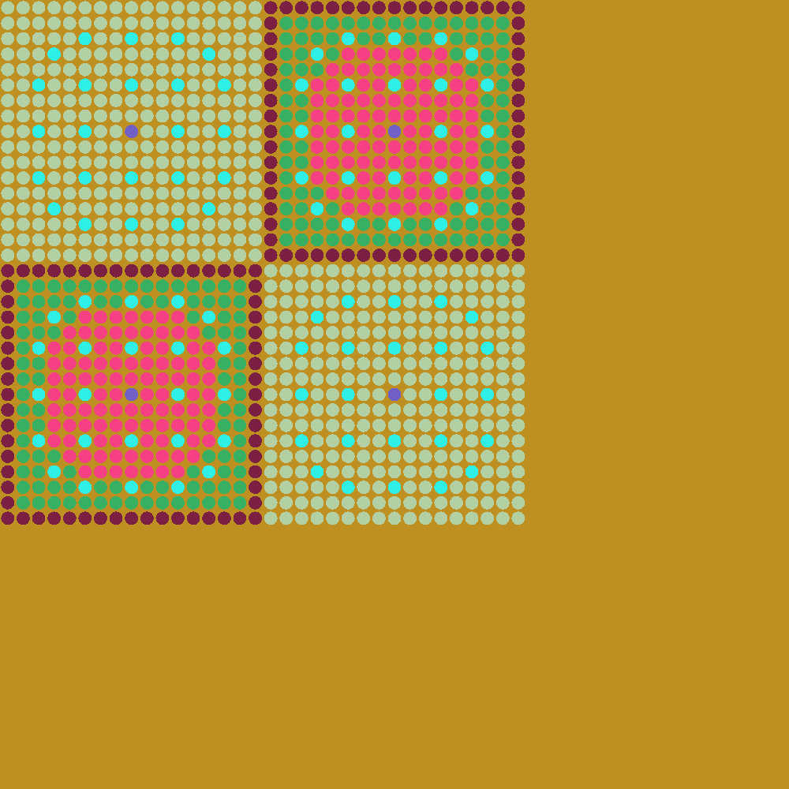
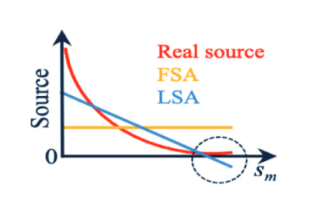
Linear Source Motivation
Linear Source approximation –
Allow coarser discretisation,
Decreased computation time,
While maintaining/improving accuracy.
a) Source order comparison.
b) C5G7 benchmark geometry.
Fig. (a) – [5] Choi, S., Fitzgerald, A., Herring, N., & Kochunas, B. (2024). Linear Source Approximation in MPACT for Efficient and Robust Multiphysics Whole-Core Simulations. Nuclear Science and Engineering. https://doi.org/10.1080/00295639.2023.2224234
Notes:
So before I go over some of the LS equations.
Why would we want to consider a LS approximation.
So I said the general assumption is a flat source, in actuality the source in each region has a 1/r**2 relationship,
A “linear” source better approximates this. FIGURE
By utilizing a linear source we should be able to allow for coarser discretization as well as coaser track laydowns.
This hopefully allows for decreased computation time
and we want to achieve this all with the same or improved accuracy.
Image b) is the C5G7 benchmark that we will be using for the testing of LS.

Slide 4
Source Approximations
Flat source (FS) approximation -
FS angular flux calculation -
Linear Source (LS) approximation -
LS angular flux calculation -
LS angular flux moments calculation -
[1]
[2]
[3]
[4]
[5]
Notes:
Rational Functions, x1
X2
Source gradient – solving for spatial moments

Slide 5
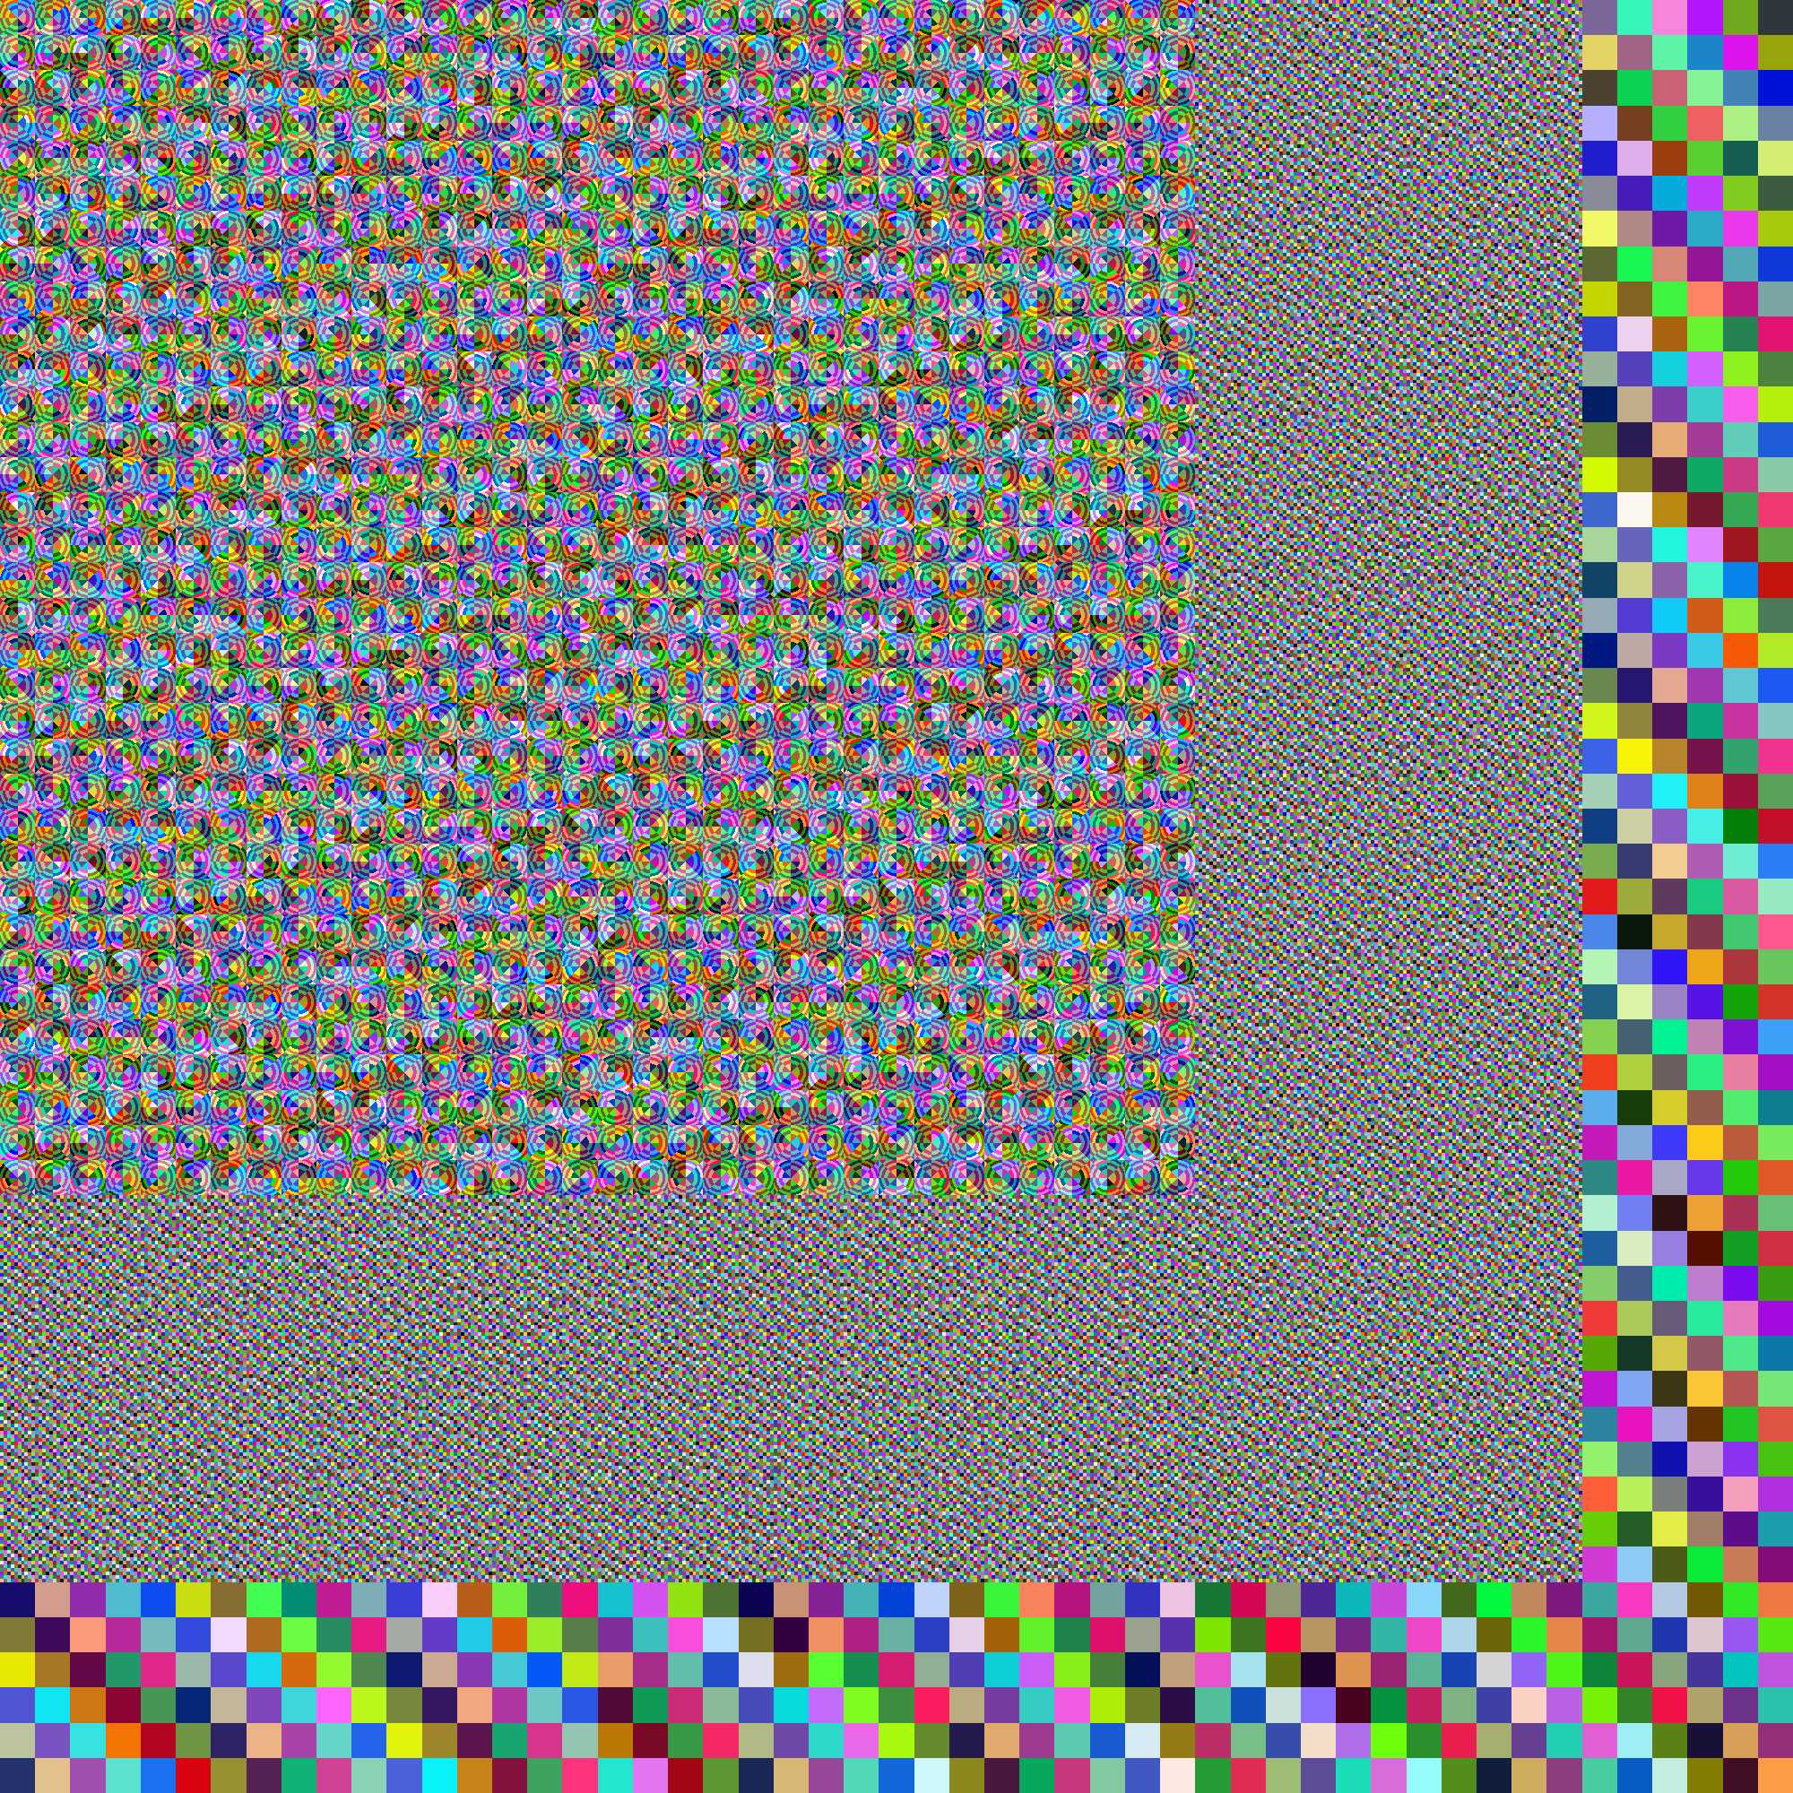
C5G7 fine + coarse mesh
Notes:
A LS approximation was implemented into SCONE, Cambridges in-house monte carlo code, which already had a random ray solver.
To test our LS approximation, we used the C5G7 benchmark that I showed earlier, alongside these two discreisations, the fine and coarse respectively.
As its slightly difficult to see whats going on, here is a magnified view.

Slide 6
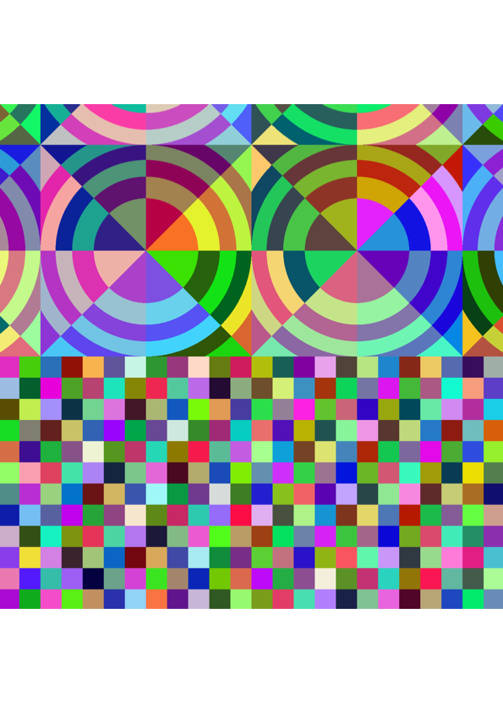
C5G7 fine + coarse mesh (magnified)
*AD = Azimuthal Divisions, F/M = Fuel/Moderator
Notes:
again for the fine and coarse respectively,
the key takeaways,
reduced the rings in the fuel and moderator inside the pins.
reduced anglar divisions in pins,
reflector region 5x coarser,
leading to
x10 fewer cells

Slide 7
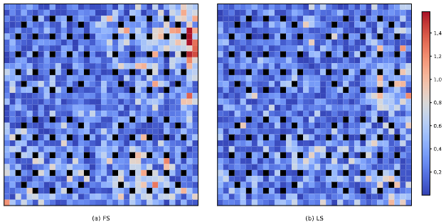
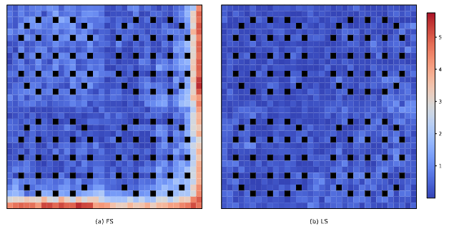
Linear Source Results I
Pin Power Error (PE): Fine mesh – FS/LS Coarse mesh – FS/LS
Notes:
Testing on these two mesh lead to these graphs, where we are displayed the percentage absolute pin power error in each pin across the four assemblies, all are relative to a MC reference solution
describe graphs - axis difference
similar magnitude of error for top
much larger for bottom error.

Slide 8
Linear Source Results II
FS is very inaccurate with coarser mesh.
LS achieves lower power error than FS/Fine on both mesh.
LS achieves lower k_eff error than FS/Fine on both mesh.
*MPE = Maximum Pin Power Error, APE = Average Pin Power Error
Notes:
Onto the results
I hope the tables are self explanatory, but important points are listed, all numbers are averaged over 8 runs.
The key cases to look at 1st and 4th, that is FS fine vs LS coarse.
FS is very inaccurate with coarser mesh.
LS achieves lower power error than FS/Fine on both mesh.
LS achieves lower keff error than FS/Fine on both mesh.
We then looked at....

Slide 9
Linear Source Results III
LS significantly reduces runtime compared to FS, being faster both in parallel and serial execution (1.4x/1.7x).
LS has a higher memory requirement than FS, particularly on fine meshes, but this difference diminishes on coarse meshes.
As TRRM is innately 3D, we expect larger improvements with LS in 3D problems.
*TPI = Time Per Intersection
Notes:
TPI – time per integration - the time it takes to ray trace across a single mesh cell and perform all associated geometric and flux operations (per group)

Slide 10
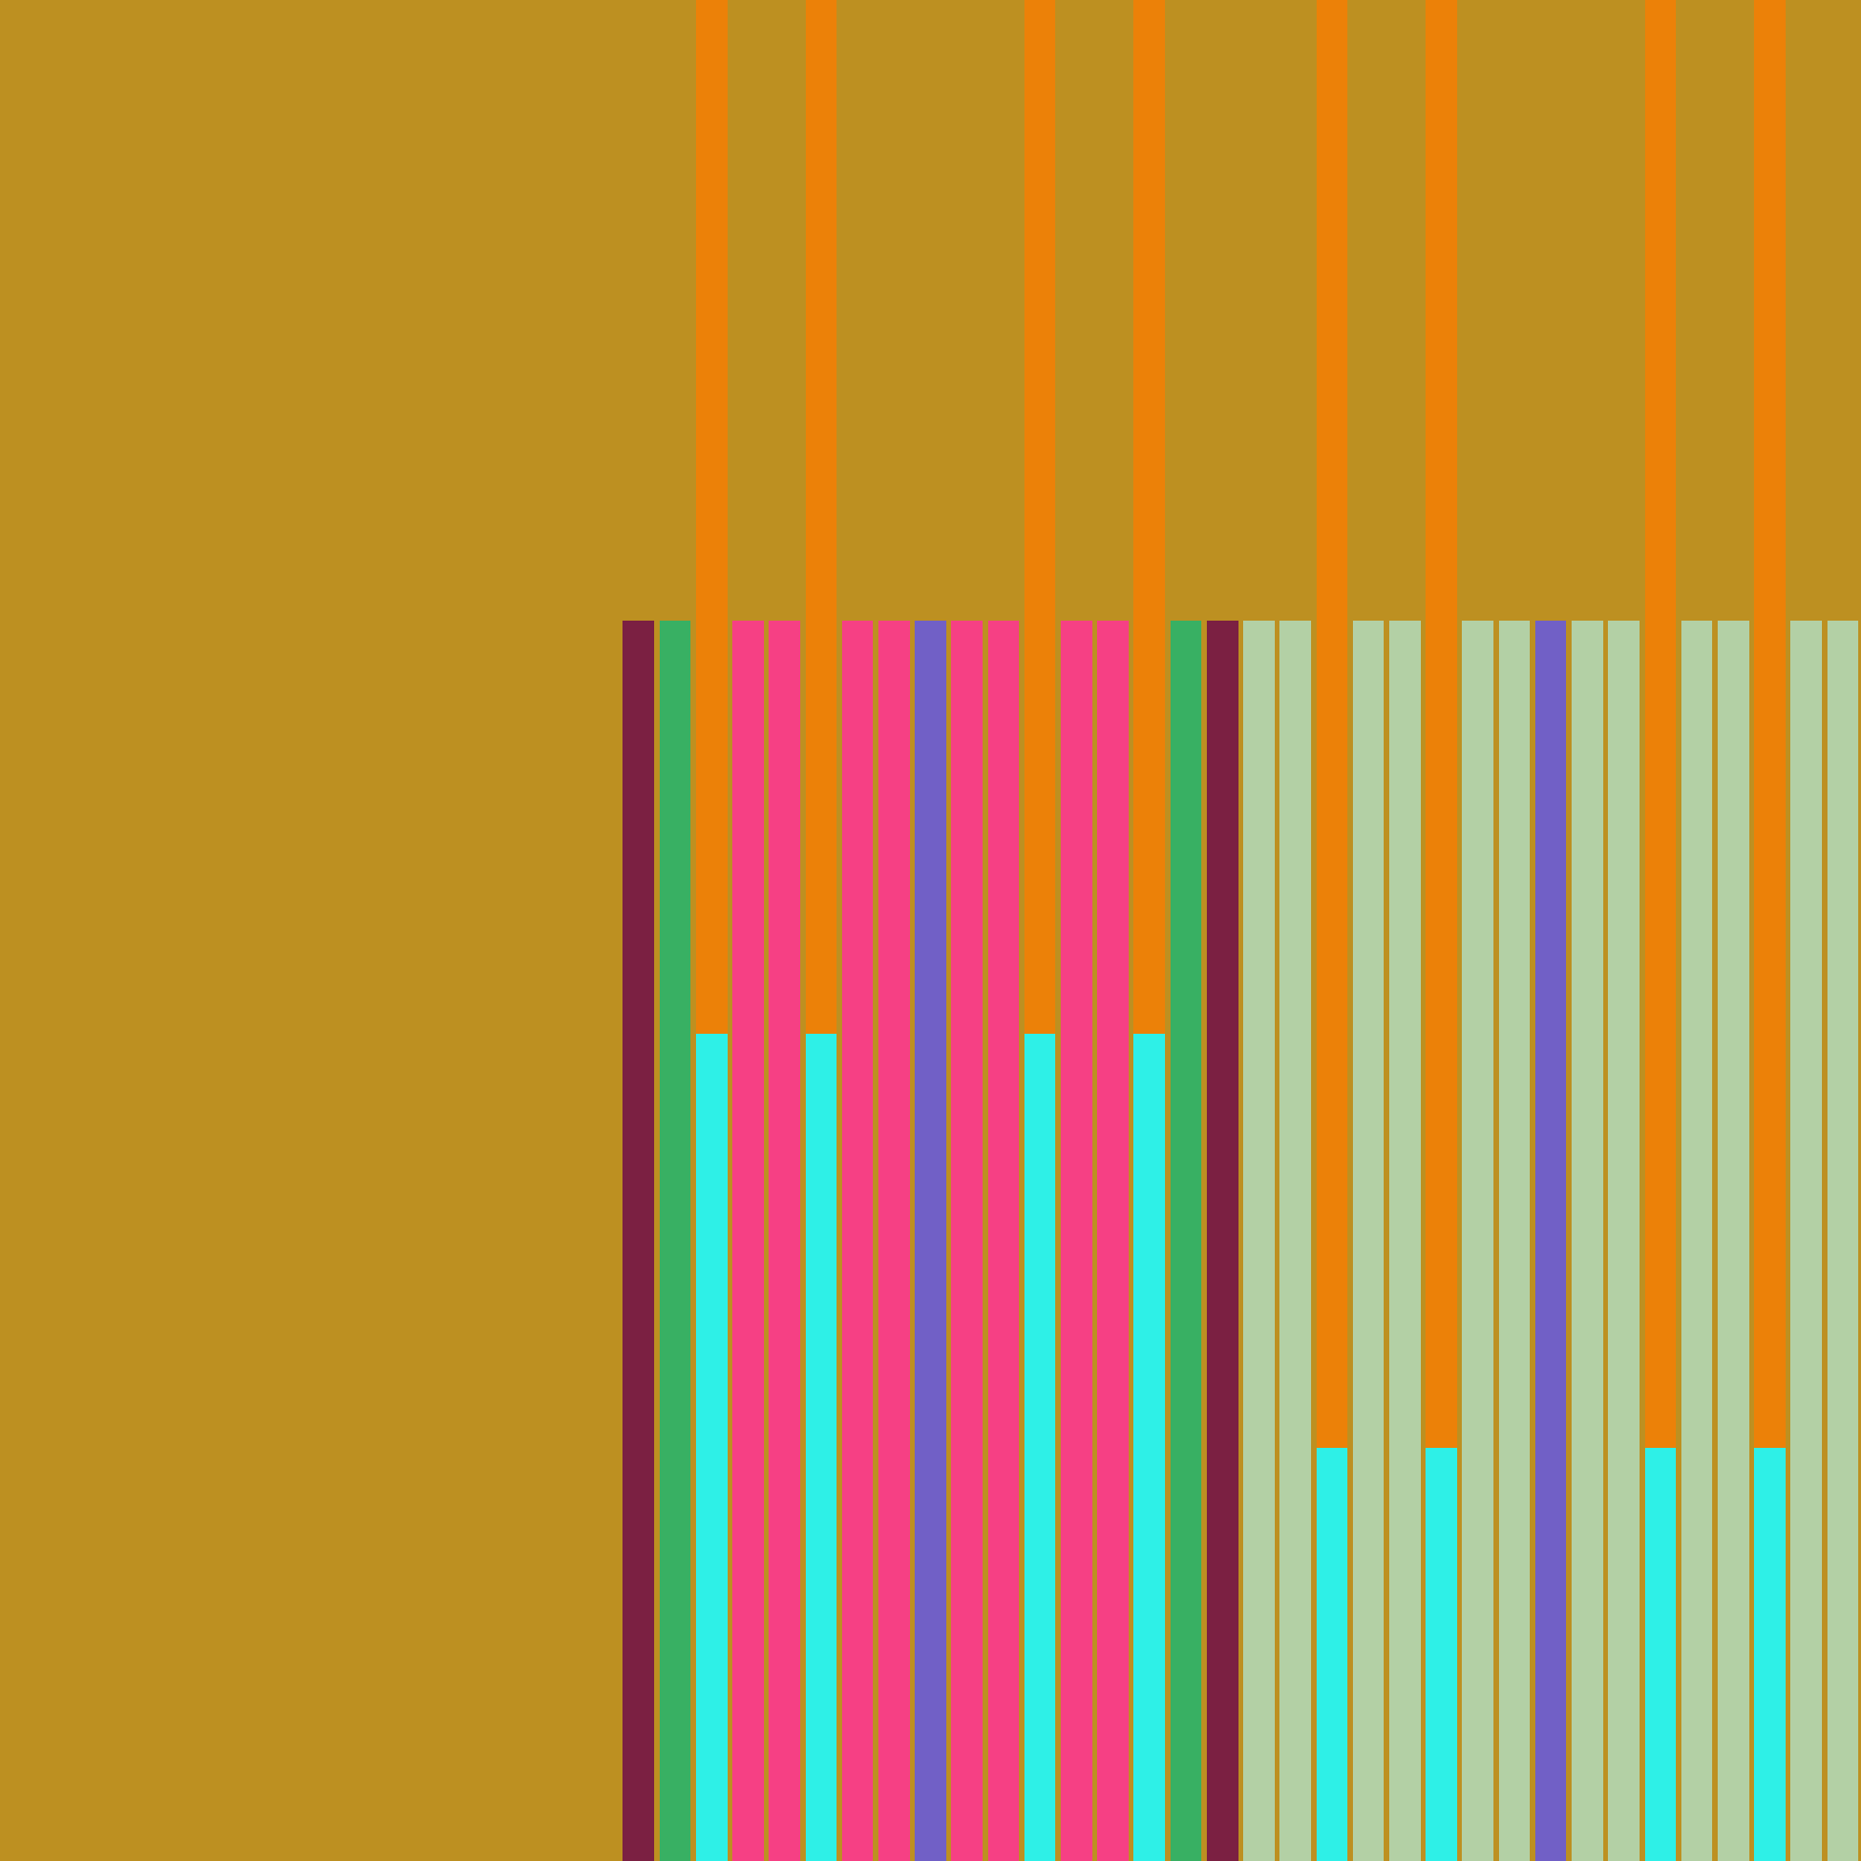
C5G7 Rodded B (3D extension case)
Already tallying in 3D.
Tested on C5G7 Rodded B.
a) C5G7 Rodded B benchmark geometry.
Notes:
So then we tested on 3D C5G7 – Rodded B. When doing this we varied and ray populations (RP).
Rapid increase as we coarsen the FS discretization. Relatively large PE
LS cases show relatively constant PE, even slightly improved. While Keff reminas low for much coarser

Slide 11
Linear Sources in 3D - Results I
Same 2D Mesh (Fine/Coarse).
RP (Ray Population) of 117k.
LS cases outperform all FS cases in terms of PE.
Comparable keff error (1,4), up to 25pcm error (6).
*ZD = Axial Divisions, RP = Ray Population, PE = Error in the Maximum Powered Pin.

Slide 12
Linear Source in 3D – Results II
Results for the power error in assemblies alongside runtimes and memory usage.
Up to 4x lower assembly power error (1,6), (1,5).
Up to 5x runtime speedup (1,6).
Up to 10x lower memory footprint (1,6)
Comparable keff error with 1.5x speedup (1,4).
Notes:
- **Error and Speed-Up**
- Reducing FS axial divisions can significantly affect $k_\mathrm{eff}$ error.
- **Power Errors (PE)**
- LS consistently outperforms FS in power error reduction.
- PE decreases as axial divisions and ray populations are reduced, especially in LS cases.
- FS shows higher errors when using coarser meshes.
- Reducing axial divisions leads to over $10\times$ memory reduction in coarsest LS cases compared to fine FS cases.
- LS offers speed-ups up to $5.3\times$ with acceptable $k_\mathrm{eff}$ accuracy impacts ($10-26$ pcm).
- **Overall Benefits of LS TRRM**
- Provides flexibility and significant speed-ups with manageable errors.
- Allows altering simulation parameters for optimized performance.
- Demonstrates clear advantages in power error and memory usage over FS.

Slide 13
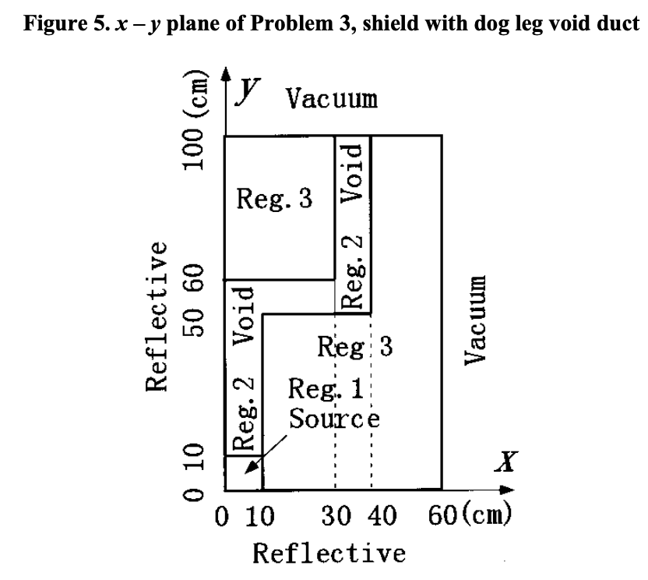
LS Fixed Source - Results I
Fixed source – Dogleg benchmark.
Initial 1x1x1cm mesh, population of 10k
Coarse 10x10x10cm mesh, population varied.
Comparable MFE and AFE with 14.7x speedup.
*MFE = Maximum Flux Error, AFE = Average Flux Error

Slide 14
LS GPU
Previous work has demonstrated that TRRM with an event-based algorithm offers efficient GPU scalability.
Ideal for large loops over many energy groups.
2.6 – 5.5x FS speedup over CPU node architectures [6].
Recent work has implemented LS into OpenMC random ray.
Testing on C5G69, C5G69 Rodded B and HM core slice.
[6] Tramm, J.R., Siegel, A.R. & Romano, P.K., (2019). An event-based algorithm for random ray neutral particle transport on GPUs.
Notes:
GPUs make up 90% of total compute

Slide 15
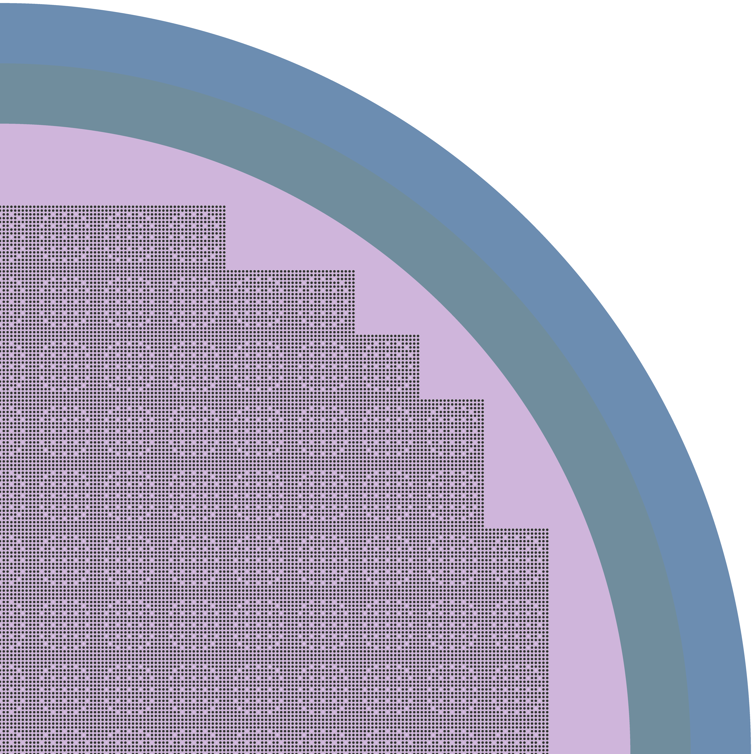
LS GPU 2D Hoogenboom-Martin (HM)
Quarter 2D core of PWR-like HM reactor.
Hot Borated Moderator
Triple Layered Fuel Pins (fuel clad moderator).
a) Fuel Pins
b) Core Layout

Slide 16
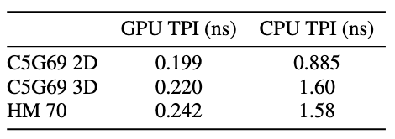
LS GPU - Results I
GPU - NVIDIA A100
CPU - AMD Ryzen Threadripper node 128 threads.
Three test cases, C5G69, C5G69 Rodded B and HM with 70 energy groups:
TPI Speedups of 4.45x, 7.27x, 6.53x.

Slide 17
Summary
LS offers significant speedups over FS, up to 5.3x.
The use of coarser mesh reduces memory footprint up to 10x and reduced power error.
Initial GPU testing shows LS scales well on GPU, offering further speedups up to 7.27x

Slide 18
References
Tramm, J.R. (2018). Development of the random ray method of neutral particle transport for high-fidelity nuclear reactor simulation.
Ferrer, R.M. and Rhodes, J.D. (2016). A Linear Source Approximation Scheme for the Method of Characteristics. Nuclear Science and Engineering, 182(2), pp.151–165.
Gunow, G.A. (2018). Full core 3D neutron transport simulation using the method of characteristics with linear sources. (Doctoral dissertation, MIT).
Fitzgerald, A. (2020). Parallel 3-D Method of Characteristics with Linear Source and Advanced Transverse Integration. (Doctoral dissertation, University of Michigan).
Choi, S., Fitzgerald, A., Herring, N., & Kochunas, B. (2024). Linear Source Approximation in MPACT for Efficient and Robust Multiphysics Whole-Core Simulations. Nuclear Science and Engineering.
Tramm, J.R., Siegel, A.R. & Romano, P.K., (2019). An event-based algorithm for random ray neutral particle transport on GPUs.

