Slide 1
Technical Session 2 – Nuclear Data
Dr Robert Mills
Senior Nuclear Physicist,
Nuclear and Reactor Physics Team

Slide 2
Nuclear Data
What is it? Why do we need it?

Slide 3
Nuclear Data
The complete data describing the relevant nuclear physics for the simulation of nuclear systems. This includes many types of data, such as particle and nuclei interaction probabilities, emitted particle energy spectra and angular distributions, fission product yield probabilities, decay properties and more. Strives for self-consistent and complete parameters for important nuclides and their reactions, often simplified or processed for rapid use by applications.
To provide all of these data, large national and international programmes have been created to produce and maintain the databases of these physics, which are referred to as “nuclear data libraries”. These libraries are assembled through a complex process that involves many thousands of differential experimental data sets, sophisticated nuclear reaction modelling theory, inferences from large-scale experiments that are sensitive to changes in nuclear physics and a suite of software tools that prepare application-specific databases for all users. For organisations to use these data, they also need to be rigorously verified and validated using a set of benchmark experiments that are representative of the systems of interest.
(https://www.oecd-nea.org/jcms/c_12919/nuclear-data)

Slide 4
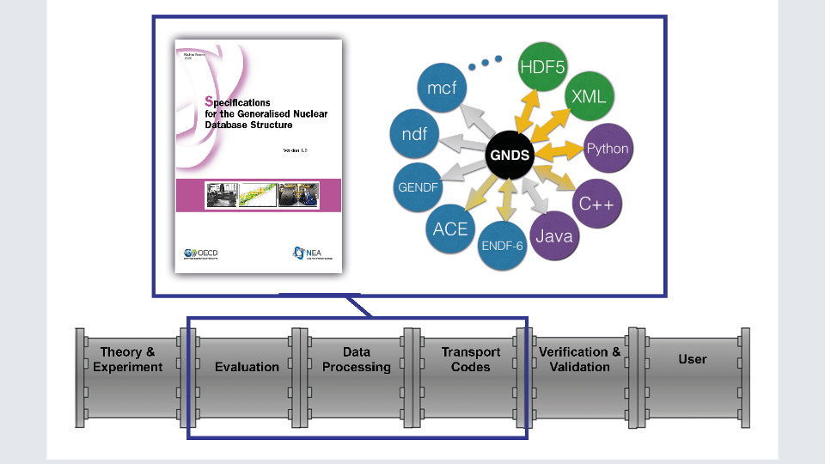
Nuclear Data Libraries
Traditionally produced in
Evaluated Nuclear Data File
format (ENDF) [80-character
text line structure, designed
to be read by Fortran],
but work on-going
internationally through the
OECD-NEA to produce a
modern Generalised Nuclear
Database Structure (GNDS)
to replace this with all the
necessary processing tools.
(https://www.oecd-nea.org/jcms/pl_37782/the-generalised-nuclear-database-structure-establishing-an-international-nuclear-data-standard)

Slide 5
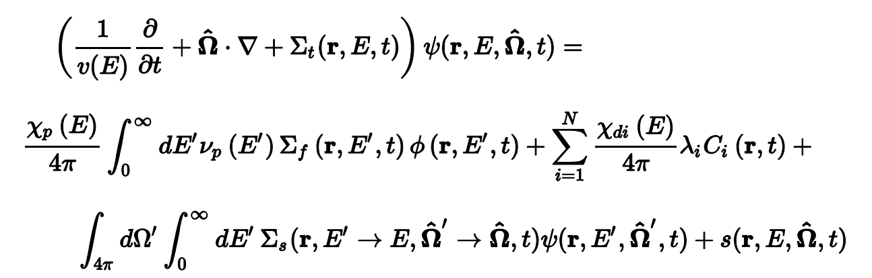
Neutron transport equation

Slide 6







Neutron transport equation

Slide 7
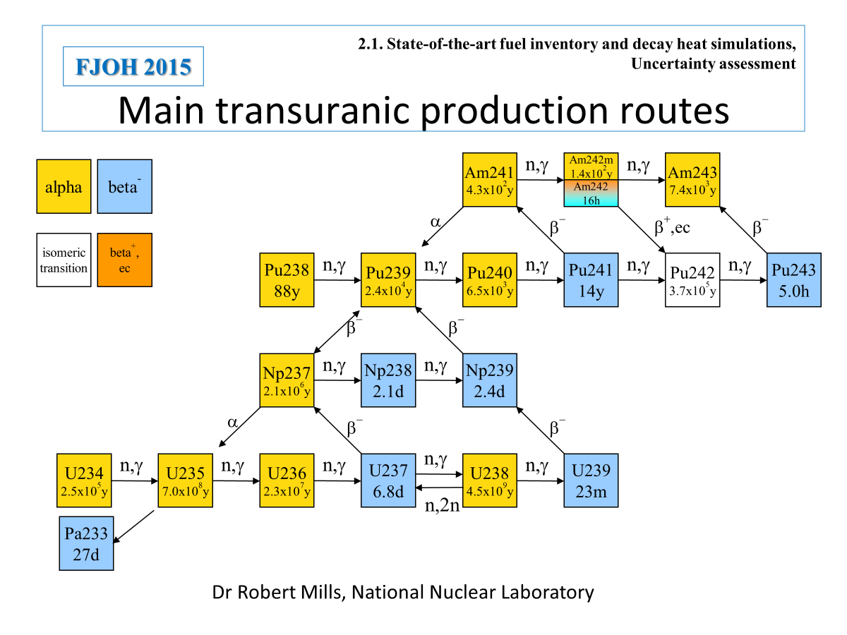

Slide 8
Nuclide production/destruction equations
Destruction by decay
and neutron capture
Production by decay
and neutron capture
Production by fission

Slide 9







Nuclide Production/destruction equations
Destruction by decay
and neutron capture
Production by decay
and neutron capture
Production by fission

Slide 10
Nuclear Data
Major Projects and
development work

Slide 11
Who produces and distributes nuclear data
Evaluation (mostly volunteer) projects:
JEF/JEFF Western Europe + South Korea collaboration
Joint Evaluated File/Joint Fission Fusion File
ENDF USA Evaluated Nuclear Data File
JENDL Japan Japanese Evaluated Nuclear Data Library
FENDL IAEA, Fusion Evaluated Nuclear Data File
CENDL China, Chinese Evaluated Nuclear Data Library
Former Eastern bloc files e.g. BROND and RUSFOND.
Note contributors produce component parts with project directing aims to solve their specific needs, compilation of “complete” files from parts or parameter sets and drive testing.
The projects don’t fund work but act as forums when users and specialists can collaborate.
Projects tend to be very open and encourage collaboration within their areas.
Different projects have a different focus on applications needing to be simulated.

Slide 12
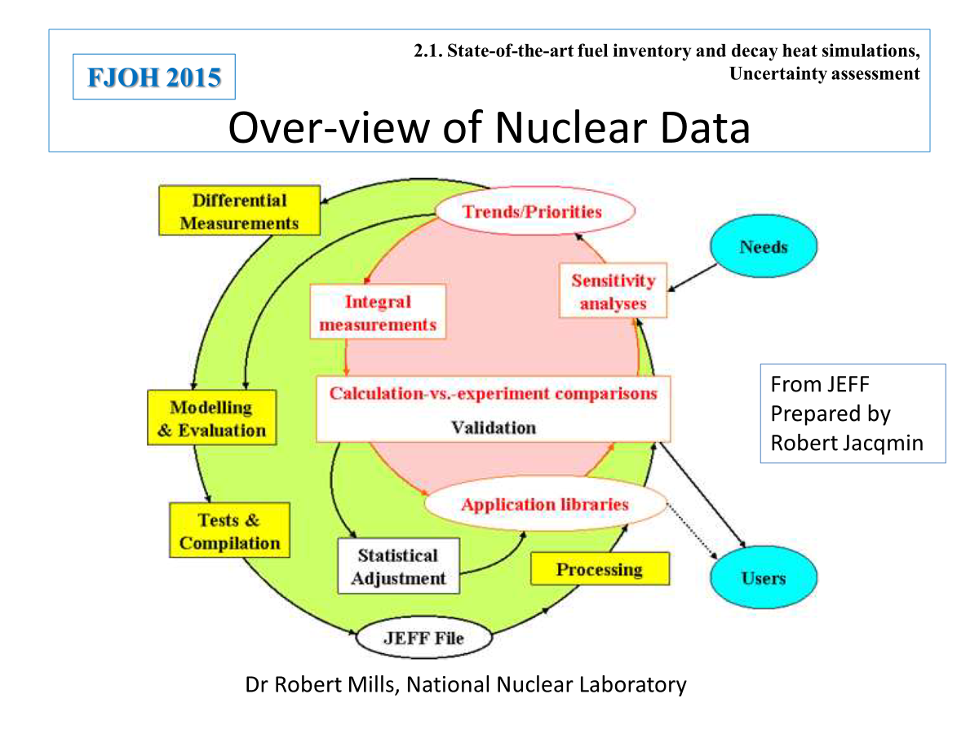
Trends
1960-1985
Initialise and produce complete libraries
1985-2000
Improve agreement with benchmarks
2000-now
Improve understanding of uncertainties and their covariances for uncertainty quantification.

Slide 13
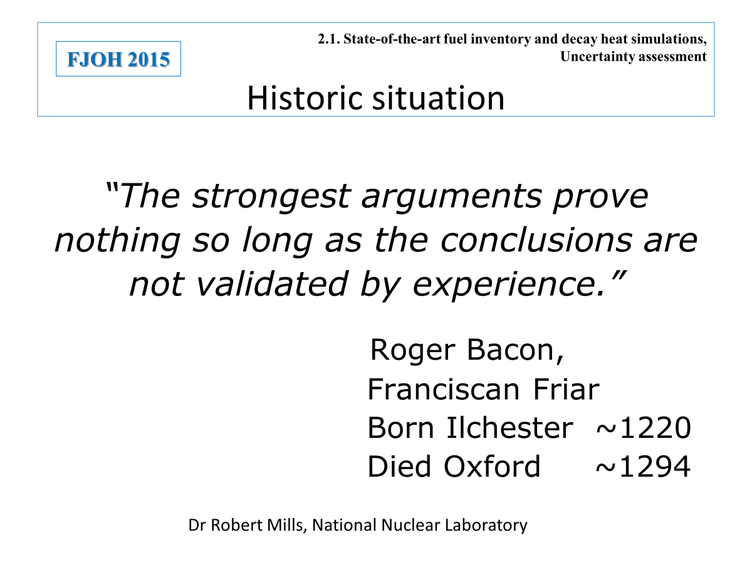

Slide 14
Interproject collaboration
Working Party on International Nuclear Data Evaluation Cooperation (WPEC), OECD/NEA.
Members are projects not countries.
Established to promote the exchange of information on nuclear data evaluations, measurements, nuclear model calculations, validation, and related studies.
Projects often have the same issues to resolve, these are done by:
General meeting to discuss work of different projects.
Short term sub-group (1-3 years) to focus on a specific problem with interested parties from all projects coming together to study the issue and write report on issues and possible solutions. [50 sub-groups so far].
Long-term sub-groups; e.g. Data format sub-group and High Priority Request list

Slide 15
NEA Nuclear Data High Priority Request List
WPEC Expert Group on the High Priority Request List (EGHPRL) for Nuclear Data
Purpose
Maintains and periodically reviews list of high priority nuclear data requests.
Stringent criteria are applied for entries based on need, available data and methods.
Request types are:
  A high priority request, which is justified by strong need, quantitative sensitivity studies (or the equivalent), achievable solution and well documented.
  A general request is well motivated for a specific quantity on a specific nucleus and is documented but lacks a detailed backing by a sensitivity analysis or impact study.
  A special-purpose request in a well-defined category is of interest to a recognised important subfield of applied nuclear science for which it is essential to stimulate new activity. Such a request may not satisfy the criteria as in the cases above.

Slide 16
EGHPRL reviewing requests
Consider
If it is really needed for an application issue.
The case must uniquely identify the quantity that needs to be improved.
What is currently used and on what basis was this developed.
The case must also quantify the sensitivity of the uncertainty on measurements to the improvement of the needed parameter.
Are new experiments, theory, evaluation or validation needed to resolve?
Can these be achieved? Are they practical?
If so, request on the website is appropriately approved:
https://www.oecd-nea.org/dbdata/hprl/index.html

Slide 17
Suggested process- Engagement, Engagement and Engagement.
Liaise with project community
JEFF and ENDF groups welcome contributions and can help to advise.
EGHPRL keen to discuss new requests.
Submit to EGHPRL and iterate until accepted or rejected.
Taking a request forward:
The new request may be used by groups as part of their funding requests, if relevant.
Generally, people interested in new work in their area or improving their existing data.
However, the only way to ensure new or improved data may be to fund interactions with relevant people, and potential fund their work…
Time scales are usually long, typically multiple years/decade.

Slide 18
Nuclear Data
Recent examples

Slide 19
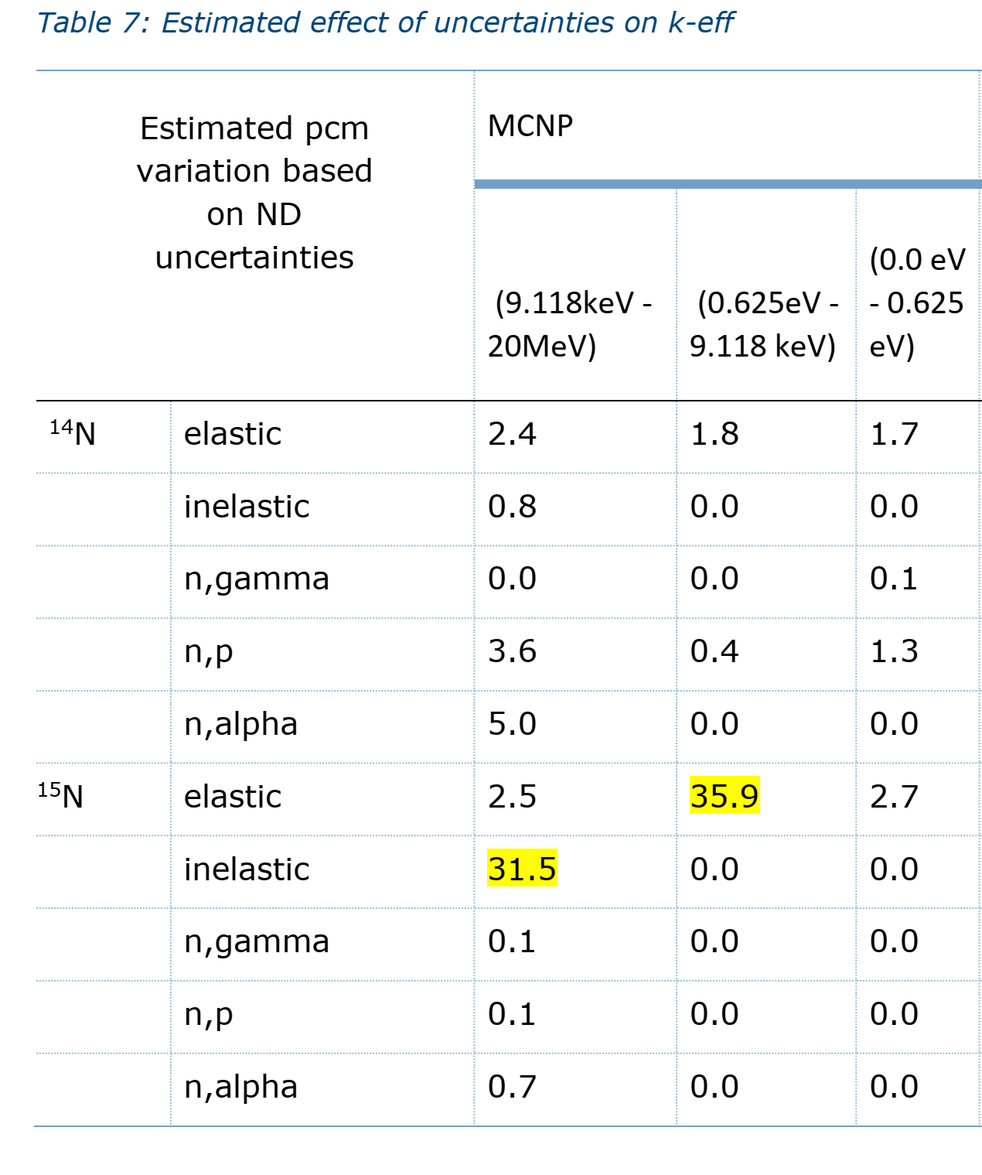
Nitrogen scattering cross-sections on ¹⁴N and ¹⁵N
UN fuels are being considered as an advanced fuel in the UK due to higher uranium density and better thermal properties. In thermal reactors need to enrich ¹⁵N to reduce ¹⁴C production.
Paper including preliminary sensitivity study discussed at EGHPRL.
Interestingly, scattering appears most important sensitivity. Nitrogen scattering measurements are mostly from 1960s and 70s.
Currently, not a priority for the UK, so not being driven forward.

Slide 20
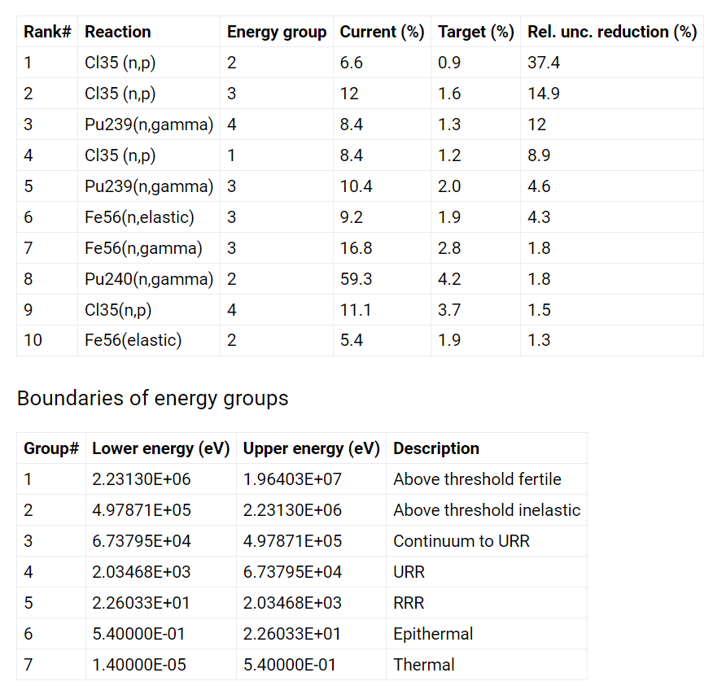
³⁵Cl (n,p) reaction in chloride molten salt fast reactors
There is currently large uncertainty in reactivity for chloride fast reactors, due mainly to the uncertainty in the Cl-35 (n,p) cross section at high energies. This is a difficulty for chloride fast reactor design because the required fissile loading has large uncertainty, and this uncertainty also propagates to other parameters important to safety, such as reactivity coefficients. Production of S-35 via this reaction is also important for corrosion.
In progress entry in HPRL.
To bring uncertainty < 300pcm need significant reduction in uncertainties

Slide 21
Thank for for your attention

