Slide 1
The Random Ray Method for Transient Simulations
Maximilian Kraus 11 September 2024 mhgk4@cam.ac.uk
Department of Engineering - Energy, Fluid dynamics and Turbomachinery

Slide 2
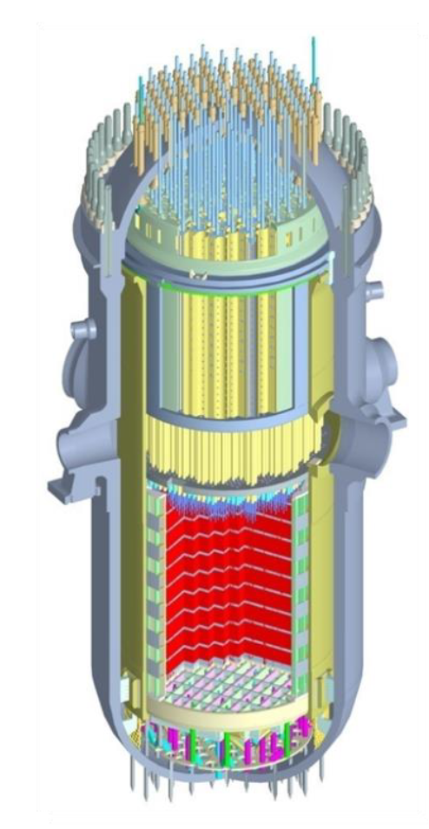
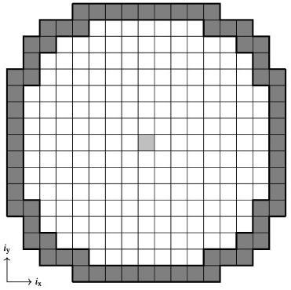
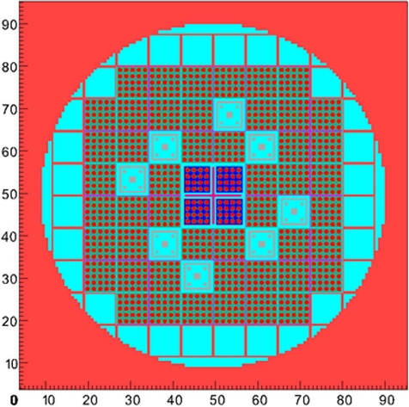
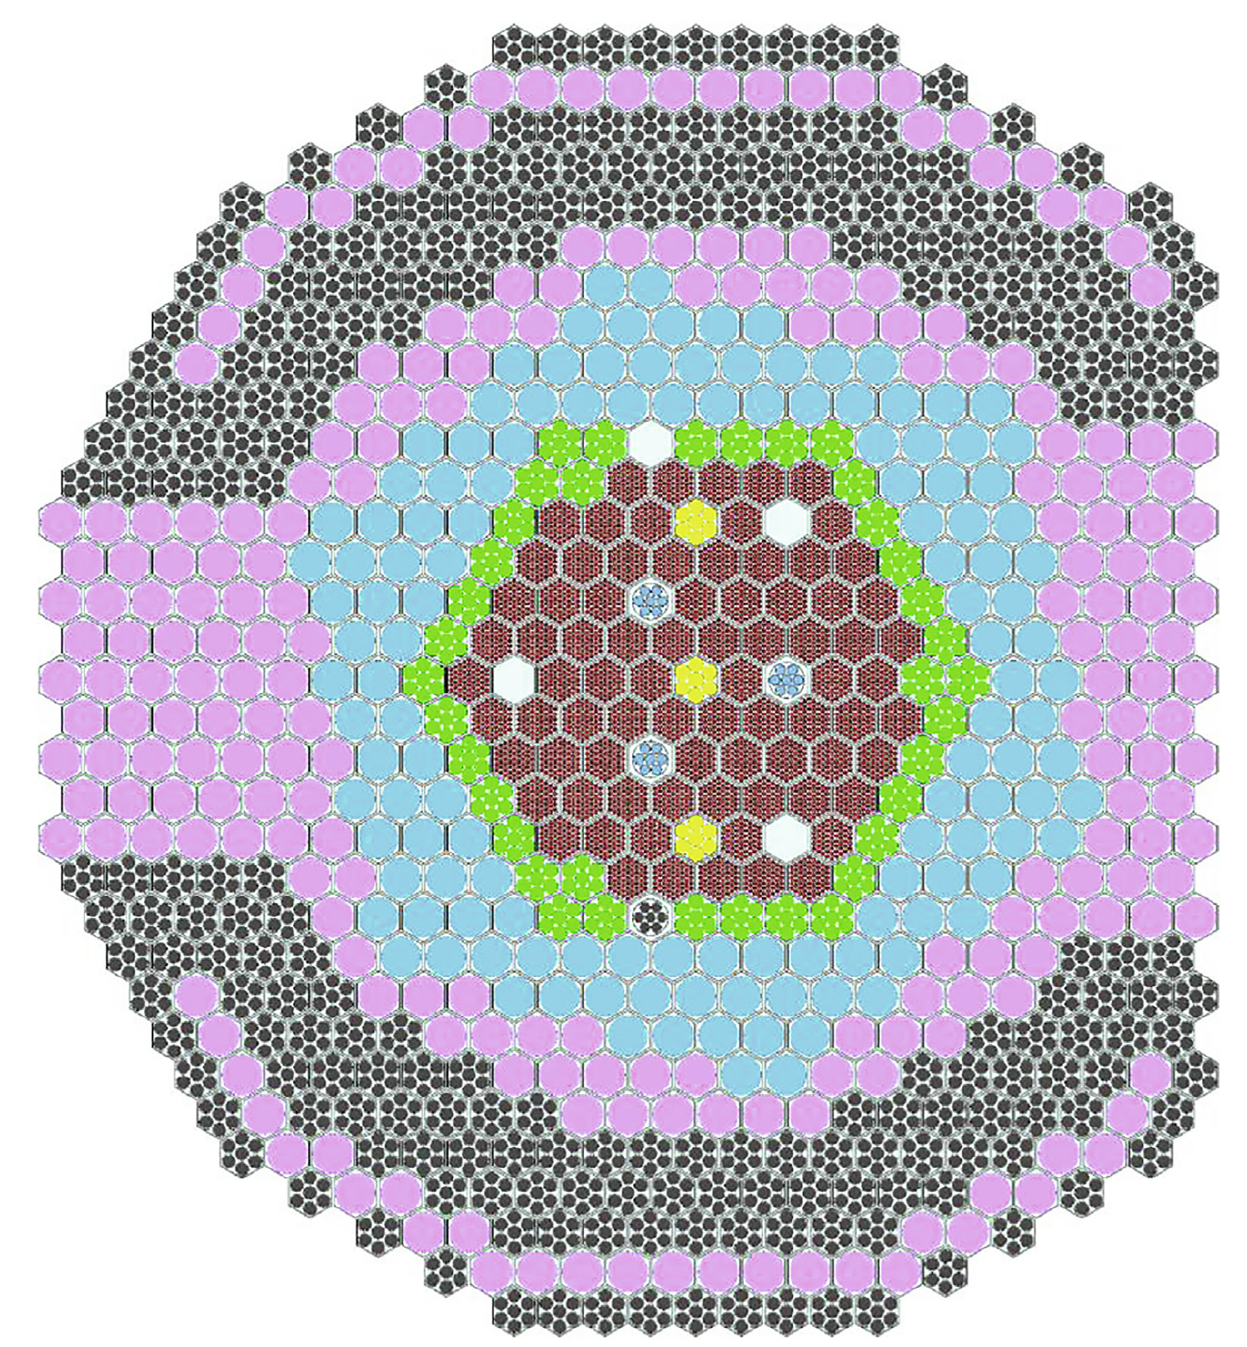
Motivation
Transient neutron transport modelling:
Precision
?
Random Ray Method
?
Run time
High-order deterministic codes
Point-kinetics
Nodal diffusion
Dynamic Monte Carlo
[1]
[2]
[3]
[4]
S5K, DYN3D, PARCS
MPACT, Griffin
SERPENT
[1] KEPCO; [2] M. Viebach, et al. “Verification of the code DYN3D for calculations of neutron flux fluctuations”; [3] L. Cao, et al. “Neutronics modeling of the SPERT III E-Core critical experiments with MPACT and KENO”; [4] E. Fridman, et al. “Dynamic simulation of the CEFR control rod drop experiments with the Monte Carlo code Serpent”
Notes:
Point-kinetics: Rough estimates, No spatial information
Nodal diffusion codes: state of the art for large LWR, Increasingly imprecise for smaller, more heterogeneous reactors
Dynamic Monte Carlo: High precision, high computational cost
HOLO: point-kinetics and diffusion, CMFD, MOC, or even MC
Area of ongoing research to minimise the trade-off between speed and precision and since TRRM performed well in these regards for steady-state calculations I wanted to look at how it does for transient problems

Slide 3
Contents
Method of Characteristics and Random Ray Method
Time-dependent approaches:
Time-implicit approach (RR-TI)
Time-continuous ray approach (RR-TCR)
Results for C5G7-TD benchmarks
Conclusions

Slide 4
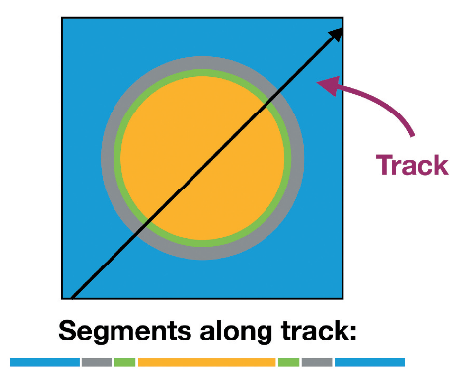
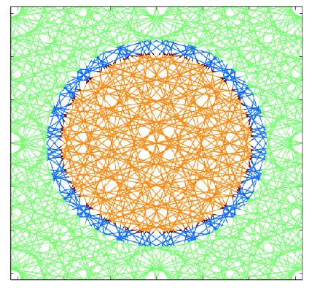
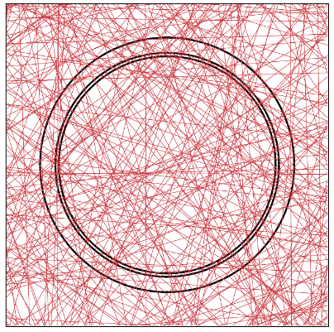
Method of Characteristics and The Random Ray Method (TRRM)
$$\left.Ω⋅∇ψ(r,Ω)+Σ^{t} (r)ψ(r,Ω)=Q(r,Ω\right)$$
Steady-state neutron transport equation:
Rewrite in characteristic form:
Solve across tracks in mesh regions
Accumulate scalar flux:
($ψ$ … angular neutron flux)
streaming
reaction rate
source
$$\frac{dψ^{k}(s)}{ds} +Σ^{t}\left(s\right)ψ^{k}\left(s\right) =Q(s)$$
$$φ_{i}=\frac{∑_{k} ω^{k}Δψ^{k}}{Σ_{i}^{t}}+\frac{4πQ_{i}}{Σ_{i}^{t}}$$
Method of Characteristics
Random Ray Method
$$k$$
$$s$$
[5]
[6]
[6]
$$Δψ^{k}$$
Fixed (cyclic) quadrature
Stochastic quadrature
[5] D. Gaston, et al. “Method of Characteristics for 3D, Full-Core Neutron Transport on Unstructured Mesh”; [6] J. Tramm. “Development of The Random Ray Method of Neutral Particle Transport for High-Fidelity Nuclear Reactor Simulation”
Notes:
Multigroup formalism
Source term contains fission and scattering sources
Example: pin cell
TRRM: acronym; deadlength; less memory storage than regular MOC, flexible with geometries like MC; performance against MC depends on quantity of interest and number of energy groups, uniform lower uncertainty

Slide 5
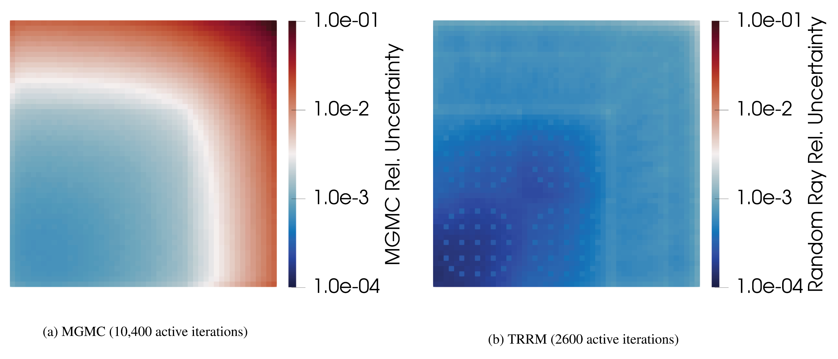
The Random Ray Method (TRRM)
TRRM
vs
Method of Characterics: ➔ much lower memory requirements ➔ higher accuracy ➔ flexible geometry
Multi-Group Monte Carlo: ➔ runtime comparison depending on energy groups and tallied quantities ➔ uniform uncertainty
MGMC
TRRM
[7]
[7] P. Cosgrove, et al. “The Random Ray Method Versus Multigroup Monte Carlo: The
Method of Characteristics in OpenMC and SCONE”

Slide 6
How about time-dependent Random Ray?
Time-dependent neutron transport equation:
Flux solution contains angular flux $ψ$ of previous time step
Problem: angular flux not stored
Two time-dependent variants proposed:
Time-Implicit Random Ray: converges time step by time step, using isotropic approximation $ψ= \frac{φ}{4π}$
Time-Continuous Random Ray: converging spatial and temporal solution together, using angular flux directly
$$\frac{1}{v}\frac{∂}{∂t}ψ(r,Ω,t)+Ω⋅∇ψ(r,Ω,t)+Σ^{t}(r,t)ψ(r,Ω,t)=Q(r,Ω,t)$$
$$\frac{1}{v}\frac{∂ψ^{k}(s,t)}{∂t}+\frac{∂ψ^{k}(s,t)}{∂s}+Σ^{t}(s,t)ψ^{k}(s,t)=Q(s,t)$$
Approximations and numerical treatment

Slide 7
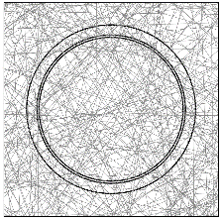
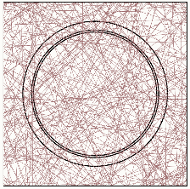
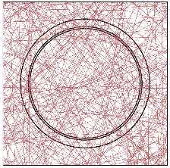
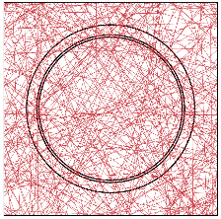
Time-Implicit Version (TRRM-TI)
For all time steps n:
Cycle 1
Cycle 2
…
$ψ_{i,n−1}= \frac{φ_{i,n−1}}{4π}$
converge
Score results
t = 1
…
For all cycles:
For all rays:
For all segments in ray k:
t = 2
converge
Score results
Calculate $ψ_{i,n}$
Calculate ${Δψ}_{i,n}$
Accumulate towards $φ_{i,n}$
…
converge
Score results
Normalise flux and add source
t = 3
…
Average and store flux
converge
Score results
$$φ$$
t = 4
…
t
Notes:
Leverages low memory requirements
Easier multi-physics updating

Slide 8
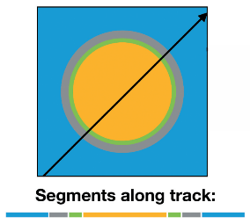
Time-Continuous Ray Version (TRRM-TCR)
Cycle 1
Cycle 2
…
For all cycles:
ray 1
ray 2
…
…
…
For all rays:
Score results
For all segments in ray k:
For all time steps n:
Calculate $ψ_{i,n}$
Calculate ${Δψ}_{i,n}$
Accumulate towards $φ_{i,n}$
segm. 1
segm. 2
…
t = 1
Update $ψ_{i,n−1}←ψ_{i,n}$
converge
Normalise flux and add source
t = 2
…
Average and store flux
t = 3
$$φ$$
t = 4
…
…
t
Notes:
Higher precision
Higher memory required (scalar flux + source)
Multi-physics coupling challenging

Slide 9
Simulation Setup
C5G7-TD benchmark: small LWR with 16 fuel assemblies, water reflector, surrounding vacuum
Different transient exercises
here: TD1-2: 1% control rod insertion (2D) TD3-4: 20% moderator density change (2D)
Implemented in SCONE
Comparison of Random Ray results to reference solution of MPACT [8]
[8] Shen, et al. “Transient analysis of C5G7-TD benchmark with MPACT.” Annals of Nuclear Energy, (2019).
Notes:
Methods tested on C5G7 benchmark
Quarter core geometry, reflective boundaries
Simulation parameters are chosen to match MPACT reference

Slide 10
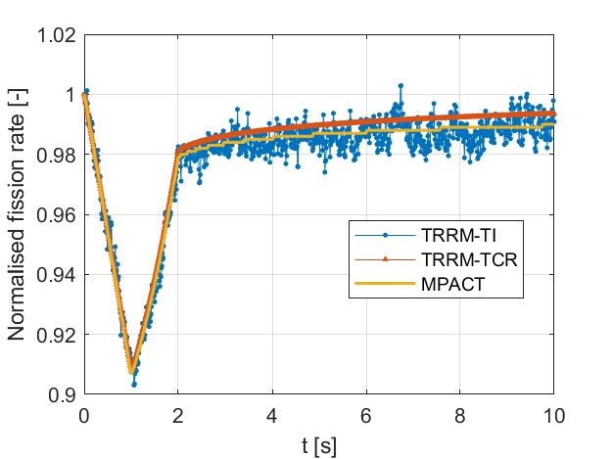
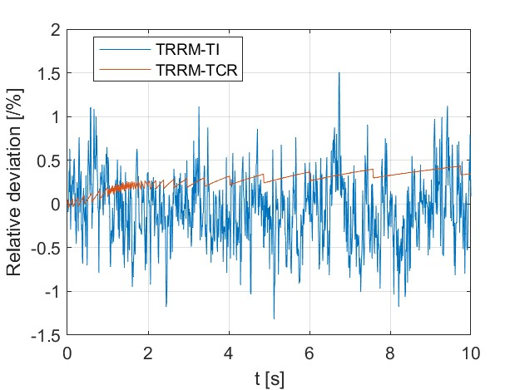
C5G7-TD 1-2 Results
Performance:
 | TRRM-TI | TRRM-TCR
Maximum deviation [%] | 1.51 | 0.43
Mean deviation [%] | 0.32 | 0.28
Memory requirement [GB] | 0.35 | 11.68
Run time [h] | 12.3 (112 CPUs) | 12.6 (112 CPUs)
Transient:
TI: $σ_{max}≈0.67 \%$
TCR: $σ_{max}≈0.58 \%$
Notes:
Explain fission rate

Slide 11
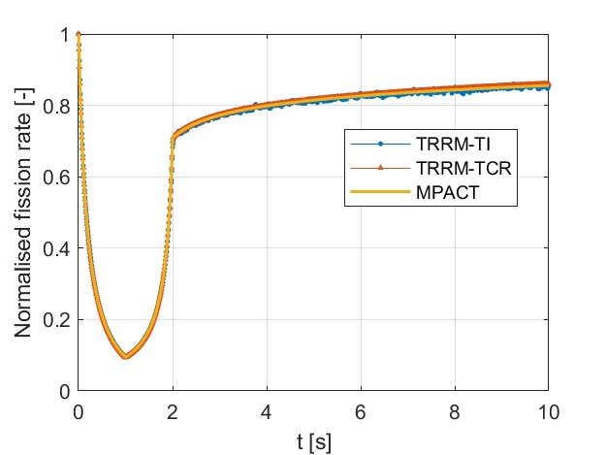
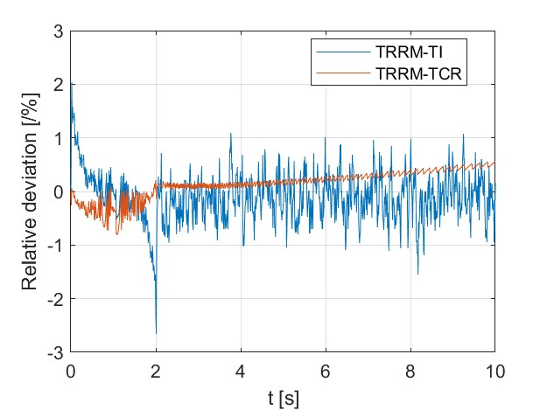
C5G7-TD 3-4 Results
Performance:
 | TRRM-TI | TRRM-TCR
Maximum deviation [%] | 2.64 | 0.81
Mean deviation [%] | 0.36 | 0.26
Memory requirement [GB] | 0.40 | 11.69
Run time [h] | 11.3 (112 CPUs) | 23.5 (112 CPUs)
Transient:
TI: $σ_{max}≈0.76 \%$
TCR: $σ_{max}≈0.60 \%$

Slide 12
Conclusion
2 time-dependent Random Ray methods presented:
time-implicit (TRRM-TI)
time-continuous rays (TRRM-TCR)
Tested on two C5G7-TD benchmarks
good agreement (< 0.4 % mean deviation)
Next steps:
Test feedback capabilities
TRRM for thermal radiative transfer
TI: | Faster, memory lower, multi-physics coupling easy
 | Error higher, more noise
TCR: | Error lower, no noise
 | Slower, memory much higher, multi-physics coupling might be problem

Slide 13
Thank you for your attention!
Maximilian Kraus mhgk4@cam.ac.uk

Slide 14
The Random Ray Method for Transient Simulations
Maximilian Kraus 11 September 2024 mhgk4@cam.ac.uk
Department of Engineering - Energy, Fluid dynamics and Turbomachinery

