Slide 1
L&S Professional Community
Rachel Hartley on behalf of Ian Horsewell ian.horsewell@iop.org
25 April 2024

Slide 2
Who is it for?
Anyone and everyone with an interest in directly or indirectly supporting physics teaching in schools and colleges
(Aspiration 1 – specialist provision in schools)

Slide 3
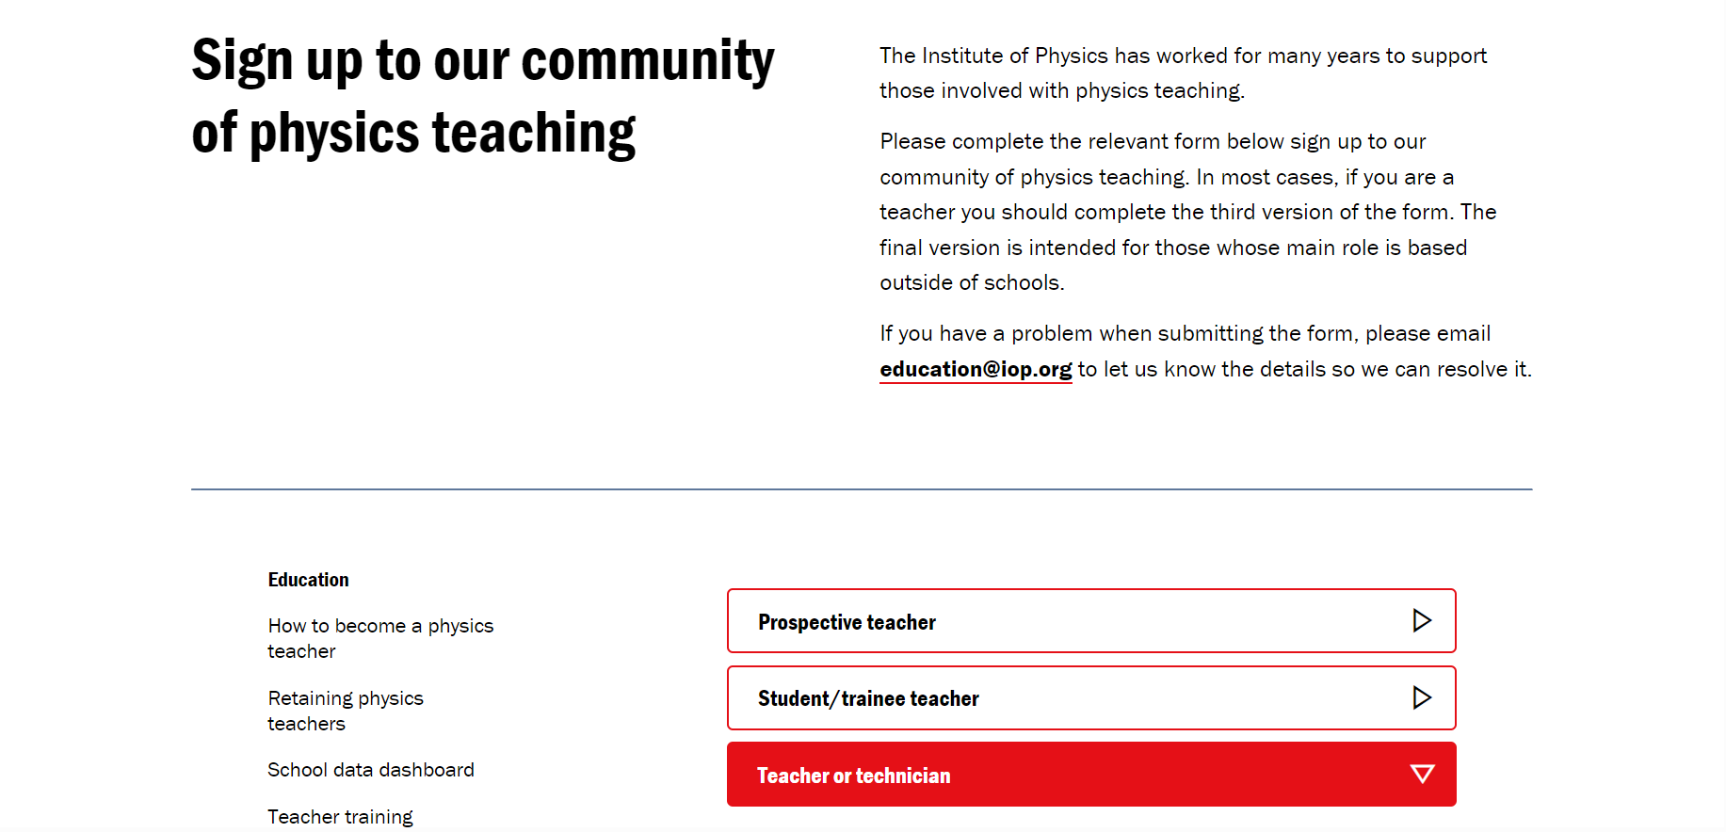

Slide 4
Monthly update
Policy and sector news
Student opportunities
Teaching approaches
Development resources and links
Events

Slide 5
Forum
As part of the sign-up, colleagues are asked if they would like to join the Teaching Forum
Regular surveys (aiming for monthly) with multiple choice questions to get quick data from the profession
Invites to less frequent, in-depth focus groups

Slide 6
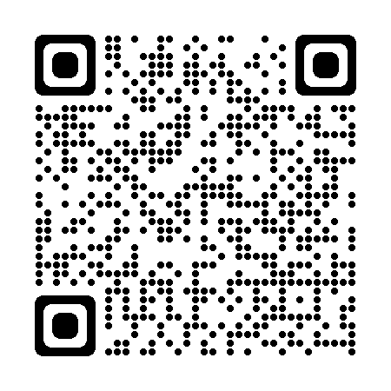
How?
Notes:
This link goes straight to the teacher-educator webform

Slide 7
Links to share
http://iop.org/community will work for anyone
We have specific links for student teachers etc to avoid people filling in the ‘wrong’ form – will be shared by email

Slide 8
Next
Please sign-up or fill in the paper form if you’re already on the limited ITE list
Share with student teachers and their mentors – for the teacher form there is a box “I support colleagues”
Contact Ian.Horsewell@iop.org with anything you’d like to be shared with the community.

