Slide 1
“Teacher retention: Using a conceptual framework to identify aspects of teacher training courses which could be enhanced to improve retention rates amongst science teachers.”
Philippa.Baker@NTU.ac.uk

Slide 2
Research questions based on
Why are increasing numbers of teachers in the UK and internationally leaving the teaching profession and is this pattern replicated in the author’s training provider?
What factors influence retention locally, nationally, and globally?
Identifying which factors can be influenced by a training institution and using these to design a conceptual framework that can be tested using feedback from previous trainees and recommendations for course design can be made.
Notes:
Research questions used to create conceptional framework.

Slide 3
Question 1 – literature review findings
The reasons why there are increasing numbers of teachers in the UK and internationally leaving the teaching profession;
Teaching outside of subject specialism - (Ofsted, 2023)
Perception of teaching outside of the profession (Low-status career) - Sims (2023).
Teachers are not attracted to teaching in deprived or rural/coastal areas - (See et al, 2020; Garcia and Weiss, 2019).
Remuneration in areas that have high living costs - (Garcia and Weiss, 2019).
Mental well-being, exasperated by the Covid-19 pandemic leading to added strain by learning new technologies, depression, and added stress - (Hays, 2020).
Notes:
These are the main findings which were found in several countries, not just the UK. Most recent source quoted.

Slide 4
Question 2 – literature review findings
Identifying the factors which positively influence retention locally, nationally and globally;
Competitive selection process for teaching as it is perceived as a valued profession often taking on the top graduates - NCEE (2018)
Teachers have space to be autonomous, collaborate with colleagues, and engage with research for the development and design of courses creating a positive and supportive working environment/community of practice (Ryan and Deci 2017).
A positive and supportive working environment/community of practice -(Heikkinen et al, 2018).
Peer mentoring program across those invested in education - (Heikkinen et al, 2018).
Pay in line with similar academic qualifications such as accountants and engineers - NCEE (2018).
Pre-service teachers receive money to buy books and computers - NCEE (2018).
Notes:
These are the main findings which were found in several countries, not just the UK. Most recent source quoted.

Slide 5
Job satisfaction (Talis 2020)
“job satisfaction as the sense of fulfilment and gratification that teachers get from their work”
TALIS found that
England has only 77% of teachers satisfied with their job.
52% of teachers in England thought they should have chosen another profession.
54% of teachers in England are content with their pay. This is higher for experienced teachers (57%), but less for early careers teachers.
Teaching and Learning International Survey, TALIS (2020, p.2)
Notes:
Job satisfaction is a global term used to influence retention, but what does it mean.

Slide 6
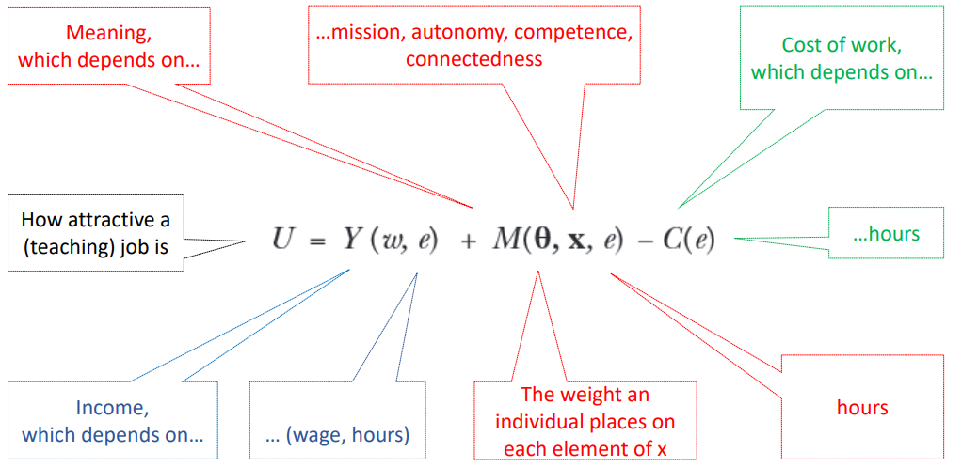
Formula adapted by Sims (2023) to quantify job satisfaction
Cassar and Meier (2018) economic-based research sought to quantify the relationships which may exist for an individual to be satisfied within their job adapted by Sims (2023).
Notes:
Use of an economic model to measure job satisfaction, which has been adapted to measure satisfaction in teaching. This slide identifies which parts can be controlled by a teacher training institution’s course and which can’t.

Slide 7
Looking at the central aspect of this formula
This related very closely to Ryan and Deci (2017) self-determination theory;
Competence,
Autonomy, and
Relatedness
The social environments discussed by Ryan and Deci include;
Autonomy and supportive.
Effectance (motivational) supportive.
Relationally supportive.
Notes:
Link made between course design and Self-determination theory.

Slide 8
What does this mean to a teacher?
Competence is the basic need to feel effectance and mastery within teaching, in other words, does the teacher feel that they have a positive impact on pupils’ needs.
Autonomy, which is more complex, at a base level is to “self-regulate one’s experiences and actions” (Ryan and Deci 2017, p.11). However, Ryan and Deci argue that external powers influence an individual’s behaviour and values, therefore SDT says only some actions are self-regulated. This aligns with many aspects of teaching such as ways to manage pupil behaviour, course content, and school initiatives. However these are frequently linked to school policies, which may conflict with an individual teacher’s viewpoint leading to discourse between external forces and intrinsic motivation.
Relatedness is how a teacher feels valued and part of the social world of teaching. A teacher may feel their viewpoint is not valued, which leaves them feeling outside the social world of teaching relatedness, so could be a factor impacting job satisfaction.
Notes:
The social environments discussed in more detail.

Slide 9
Exploring self-efficacy
Toropova et al (2021) suggest that self-efficacy could be a fundamental driver of job satisfaction and links to social cognitive theory by Bandura;
“a person's belief that they can be successful when carrying out a particular task”
Therefore, if a teacher believes they cannot be successful in terms of accountability due to pupil behaviour, they do not feel competent and so become dissatisfied with their job and so want to leave the profession.
Notes:
Self-efficacy is often mentioned within texts discussing ‘self-determination theory’ and ‘job satisfaction’.

Slide 10
Self-efficacy cont…
Azar (2010, p.176) Bandura (1997) “emphasizes that self-efficacy belief depends on four inter-related sources and this belief occupies an important place in human life”, these are:
Performance achievements that could be considered as the ‘accountability’ of teachers.
Vicarious experiences through seeing other teachers similar to oneself who are successful, thereby raising one’s self-belief.
Verbal persuasion by convincing a teacher that they can succeed.
Motivation processes (emotional state) that can be achieved in teaching through having a desire to change oneself or the environment.
Notes:
Discussion of how the 4 inter-related sources which are important for human life and self-efficacy can be associated with the teaching profession.

Slide 11
Framework design
Bandura’s theory of inter-related sources and the literature which identifies factors which impact on job satisfaction a summary table can be created.
Notes:
Factors impacting on job satisfaction divided into those negatively influencing and those positively influencing the interacted sources identified by Bandura.

Slide 12
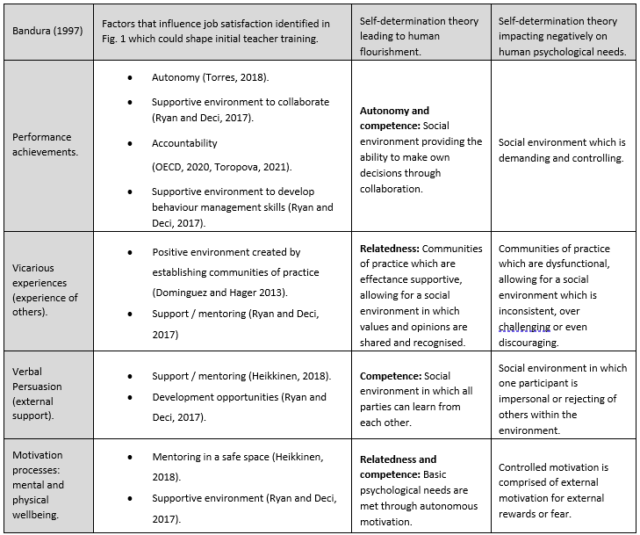
Framework design cont …
Factors such as pay, the status of teaching in society, staff shortage, workload, teaching outside of specialism, and hours worked are factors that cannot be controlled within this study; therefore only factors which could influence job satisfaction through initial teaching training were considered within the framework.
Notes:
The positive influences were then considered in terms of self-determination theory to identify factors influencing human flourishment.

Slide 13
Conceptual framework to test
Notes:
Conceptual framework design looked at the course from three perspectives; course design, placement experience and the trainee themselves. Opportunities within the course which could influence SDT were identified, and a survey was designed to gain a trainee perspective on these aspects of their training.

Slide 14
The quantitative research
Sample:
4 years of Science trainees (Sample size over 100)
50 % response rate
Online survey
Interviews with two trainees; one still teaching and 1 no longer teaching
Example:
Questions on the survey were related to Performance/autonomy and competence sought to find out the following;
Course design: Did the course allow you to develop self-confidence through autonomous motivation created by discussions of topics such as planning, behaviour, starting lessons, assessment, etc?
Placement: Did your placement schools offer you the opportunity to make decisions over your planning, experiment with innovative approaches, self-reflect, and be accountable for the progress of the pupils in the classes you taught?
Trainee: Did you engage with the social environment within your course and placement allowing you to have some autonomy over your decision-making?
Notes:
Survey questions delved into how well-prepared trainees felt for aspects of the training through the course content, placement support and their own engagement.

Slide 15
Recommendations for improving performance through developing autonomy and competence.
Notes:
Many of the responses were ones that we expected or one’s limited to a single viewpoint. Highlighted are the ones of interest to this presentation.

Slide 16
Recommendations for improving the vicarious experience through relatedness to others.
Notes:
Many of the responses were ones that we expected or one’s limited to a single viewpoint. Highlighted are the ones of interest to this presentation.

Slide 17
Recommendations for improving the verbal persuasion by external support to increase trainee competence.
Notes:
Many of the responses were ones that we expected or one’s limited to a single viewpoint. Highlighted are the ones of interest to this presentation.

Slide 18
Recommendations for improving the motivational processes.
Notes:
Many of the responses were ones that we expected or one’s limited to a single viewpoint. Highlighted are the ones of interest to this presentation.

Slide 19
References used within this presentation only (abridged version).
Garcia, E. and Weiss, E., 2019 The teacher shortage is real, large and growing, and worse than we thought: The first report in ‘The Perfect Storm in the Teacher Labor Market’ series | Economic Policy Institute (epi.org) [Accessed 22 Jan 2022]
Hays, 2020. The Staff Wellbeing Report. (Online) Available at: https://www.hays.co.uk/documents/d/global/hays-uk-wellbeing-in-education-report-2020 [Accessed 14 Feb 2022].
Heikkinen, H., et al, 2018. Understanding mentoring of new teachers: Communicative and strategic practices in Australia and Finland. Teaching and teacher education, 2018, Vol.71, p.1-11, Article 1. p.4 [Accessed 16 Feb 2022].
NCEE, 2018. Solving the Teacher Shortage Crisis: How Some Countries are Working to It. [online] Available at: https://ncee.org/quick-read/solving-the-teacher-shortage-crisis/. [Accessed 16 Feb 2022].
‌Ofsted, 2023. Finding the optimum: the science subject report. [online] GOV.UK. Available at: https://www.gov.uk/government/publications/subject-report-series-science/finding-the-optimum-the-science-subject-report--2. [Accessed 15th July 2023]
‌Ryan, R., and Deci, E., Self-Determination Theory : Basic Psychological Needs in Motivation, Development, and Wellness, Guilford Publications, 2017. ProQuest Ebook Central, http://ebookcentral.proquest.com/lib/ntuuk/detail.action?docID=4773318. Created from ntuuk on 2022-02-04 13:36:26. [Accessed 4 Feb 2022]
Sims, S., 2023. Explaining and addressing teacher shortages, UCL [Lecture to training providers held at Nottingham university] 26th April 2023.

