Slide 1
Recruitment into Postgraduate ITT (Science)
IoP April 2024
Mark Crowley

Slide 2

Aims
To review recent recruitment into Postgraduate Initial Teacher Training (PG ITT) in England – with a focus on the sciences.
To predict success against the PG ITT target for 2024-25
To review the use of bursaries and subject knowledge enhancement (SKE) courses

Slide 3
Falling short of target
140%
Primary
130%
120%
110%
Proportion of PG ITT target met
100%
90%
How is this target generated and what is the target for 2024-25?
80%
Marked drop in success against an increasing target
70%
All Secondary
60%
50%
40%
2015-16
2016-17
2017-18
2018-19
2019-20
2020-21
2021-22
2022-23
2023-24
2024-25
Training year

Slide 4
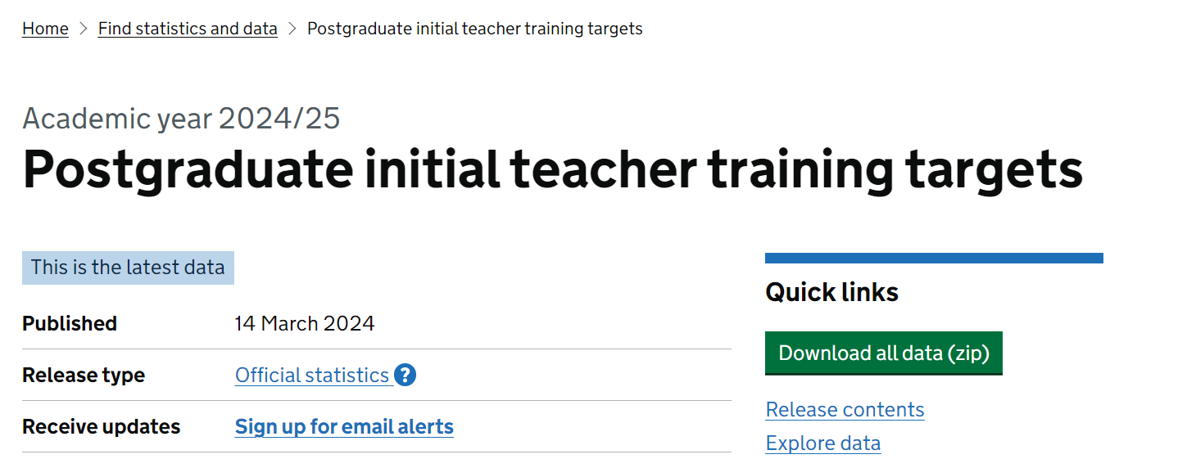
DfE determined ITT Targets
https://explore-education-statistics.service.gov.uk/find-statistics/postgraduate-initial-teacher-training-targets

Slide 5





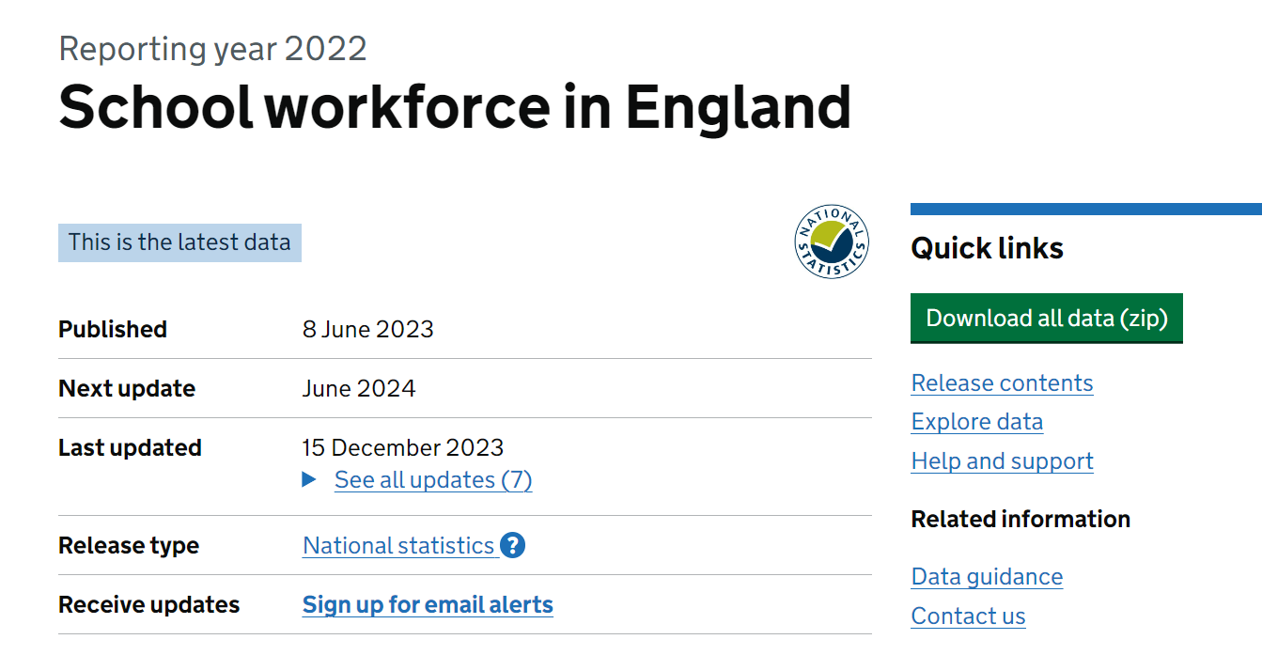


Updated DfE model for targets
Subject
hours
Number of KS1-5 pupils
(and Optimum Pupil:Teacher Ratio)
Still not made publicly available
by the DfE
Restocking with
‘Entrants’
Trainee
Target
Teacher
Workforce
Model
DfE
Policy
Under-recruitment of past two cycles
Number of
Leavers (wastage)
Current stock
of teachers
https://explore-education-statistics.service.gov.uk/find-statistics/school-workforce-in-england

Slide 6
Key Stage 3 Science hours
250,000
Biology
200.000
Chemistry
Physics
Other
Very few hours have been badged as separate specialisms at KS3 in recent rounds of the census
150,000
General
100,000
50,000
0
2011-12
2012-13
2013-14
2014-15
2015-16
2016-17
2017-18
2018-19
2019-20
2020-21
2021-22
2022-23
https://explore-education-statistics.service.gov.uk/data-tables/permalink/97a3f6d1-13aa-49ad-4c6e-08dc5d297e6b

Slide 7
Key Stage 4 Science hours
250,000
Biology
200.000
Chemistry
Physics
Other
150,000
General
Most KS4 teaching is also recorded as being delivered as “General Science”
100,000
50,000
0
2011-12
2012-13
2013-14
2014-15
2015-16
2016-17
2017-18
2018-19
2019-20
2020-21
2021-22
2022-23
https://explore-education-statistics.service.gov.uk/data-tables/permalink/97a3f6d1-13aa-49ad-4c6e-08dc5d297e6b

Slide 8
Key Stage 5 Science hours
250,000
Biology
200.000
Chemistry
Specialist subjects clearly dominate KS5 hours but note the increase in “General Science” label.
Physics
Other
150,000
General
100,000
50,000
0
2011-12
2012-13
2013-14
2014-15
2015-16
2016-17
2017-18
2018-19
2019-20
2020-21
2021-22
2022-23
https://explore-education-statistics.service.gov.uk/data-tables/permalink/97a3f6d1-13aa-49ad-4c6e-08dc5d297e6b

Slide 9
Breakdown of 2022-23 Science hours
Modelled
stock*
Trainee
Target
Subject
Biology
Chemistry
Physics
Other
General
KS3 (240,000 hr)
2%
2%
2%
1%
93%
KS4 (260,000 hr)
8%
8%
8%
1%
74%
KS5 (96,000hr)
29%
25%
20%
4%
22%
9%
8%
7%
2%
73%
35%
33%
32%
1120
1220
2250
Why such a large target for Physics?
*From the former publicly available Teacher Supply Model

Slide 10
Updated DfE model for targets
Subject
hours
Number of KS1-5 pupils
(and Optimum Pupil:Teacher Ratio)
Restocking with
‘Entrants’
Trainee
Target
Teacher
Workforce
Model
DfE
Policy
Under-recruitment of past two cycles
Number of
Leavers (wastage)
Current stock
of teachers

Slide 11
Feeding back into PG ITT targets
2020-21
2021-22
2022-23
Physics
2023-24
2024-25
Chemistry
Biology
0
500
1000
1500
2000
2500
3000
The target for all Secondary subjects has fallen from 26,360 to 23,955 (a 9.1% decrease overall).

Slide 12
Why has the Physics PG ITT Target dropped?
Slowing increase of secondary pupil numbers
More favourable supply forecasts incl deferred NQEs
Current stock of teachers is more stable.
Improved PG ITT completion rates (3% points higher)

Slide 13
Sources of information
Are fewer physics specialists leaving the profession?
Workforce data captures the number of “teachers of science” – this would incorporate non-specialist teachers (PE etc).
Could this mask the actual stability/attrition rate for that of “science specialist” teachers?
Current stock of teachers is more stable.
Current stock
of teachers

Slide 14
Use of non-specialist teachers (irrespective of the time spent teaching)
% of science teachers in England with no relevant post A level qualification
40%
Physics
30%
Chemistry
20%
Biology
10%
General
2014-15
2015-16
2016-17
2017-18
2018-19
2019-20
2020-21
2021-22
2022-23
https://explore-education-statistics.service.gov.uk/data-tables/permalink/43eb9a2d-8f07-4ebd-90e5-08dc562c85bb

Slide 15
Meeting PG ITT Targets
Teaching
Every Lesson Shapes a Life
How buoyant is current recruitment in England?

Slide 16

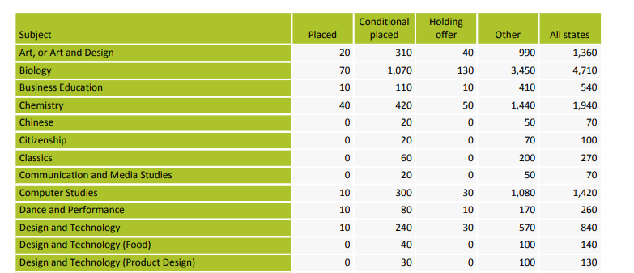

Data for PG ITT recruitment
Data from UCAS and current DfE data record monthly growth in recruited numbers but does not include applications for

Slide 17
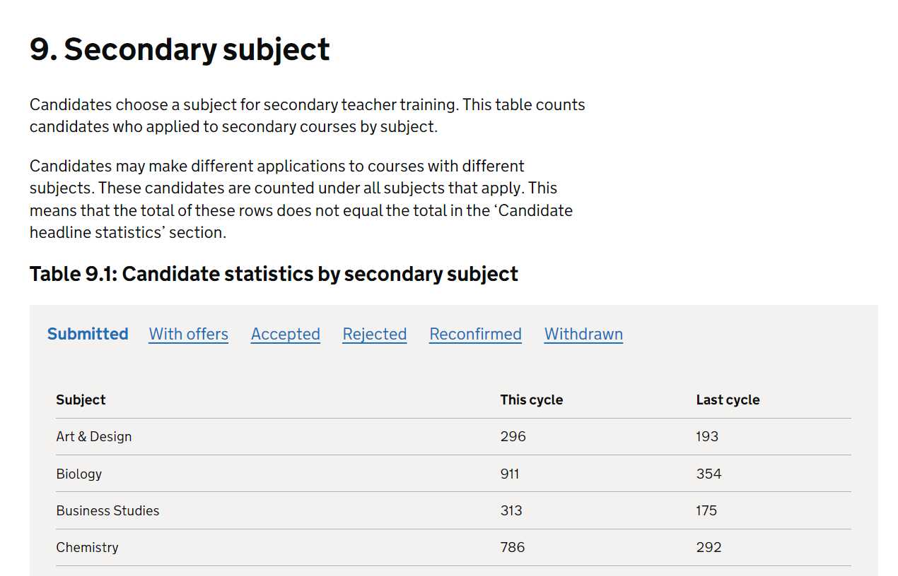
2023-24 Recruitment cycle
The DfE have changed the way data are published for the latest recruitment cycle.
“Accepted” = Recruited + Conditions Pending
But their new category “with offers” no long equates to prior UCAS and DfE Apply categories.
https://www.apply-for-teacher-training.service.gov.uk/publications/monthly-statistics

Slide 18


UCAS Data – number of successful applicants
1000
Following charts will show either raw numbers or the percentage of ITT target reached.
900
Number of applicants
800
700
2015
-
16
600
2016
-
17
2017
-
500
18
Successful Applicants =
Placed
Conditional placed
Holding Offer
2018
-
400
19
2019
-
20
300
200
100
0
Nov
Dec
Jan
Feb
Mar
Apr
May
Jun
Jul
Aug
Sep
EoC
Census

Slide 19

https://getintoteaching.education.gov.uk/help-and-support

Slide 21
Biology (raw numbers)
Recruitment improvement on last two years
2022-23
2021-22

Slide 22
Biology (against ITT target)
Once TeachFirst has been included
likely to reach 100%

Slide 23
Chemistry (raw numbers)
2021-22
2022-23
Recruitment similar to last couple of years

Slide 24
Chemistry (against ITT target)
Could make around 60% of DfE Target

Slide 25
Physics (raw numbers)
Significant improvement in PG ITT recruitment

Slide 26
Physics (raw numbers)
But last year had the greatest drop-off between applications and the subsequent census
Falling from 644 (Sept DfE Apply) to 469* in the PG ITT census
*Does not include 15 Teach First

Slide 27



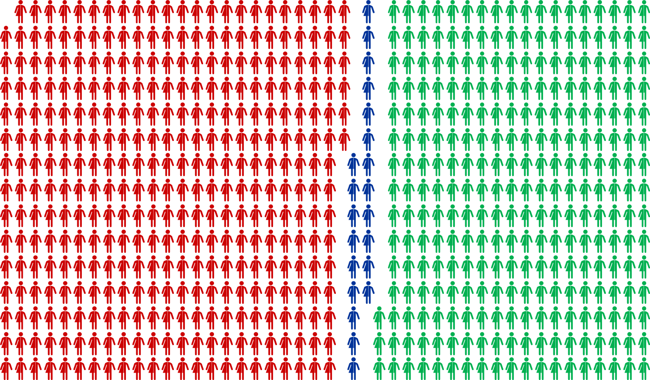
644 Acceptances
350
UK Nationals
21
EEA Nationals
273
Other nationalities
469 DfE Census

Slide 28
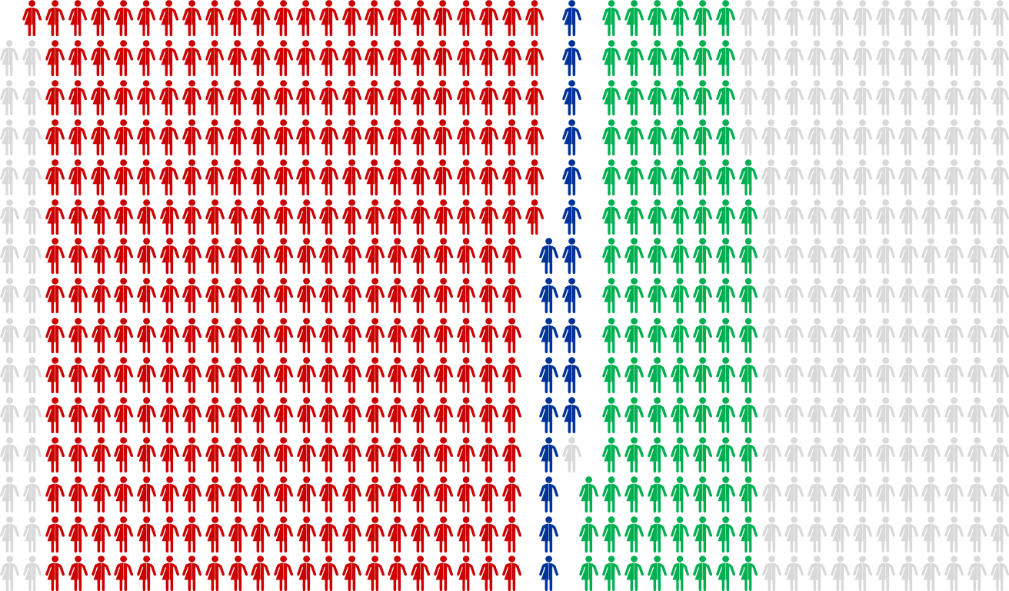
644 Acceptances
350
UK Nationals
21
EEA Nationals
273
Other nationalities
469 DfE Census

Slide 29
Acceptances ➔ ITT Census
Subject
Physics | 350 ➔ 322 | 21 ➔ 20 | 273 ➔ 104
Chemistry | 688 ➔ 636 | 30 ➔ 30 | 90 ➔ 47
Biology | 756 ➔ 834 | 38 ➔ 37 | 94 ➔ 49
Difficult to compare census data with applications due to TeachFirst

Slide 30
Physics (against ITT target)
Hence there are difficulties in modelling the likely success.
Best case ~25%

Slide 31
Meeting PG ITT Targets
Teaching
Every Lesson Shapes a Life
Bursary
+ IRP
SKE

Slide 32
Recruitment policy - bursaries
These represent a significant amount of government expenditure: up to £129 million for the 2022/23 trainee teacher cohort. However, there are often dramatic changes from one recruitment cycle to the next:
Subject | 2020-21 | 2021-22 | 2022-23 | 2023-24 | 2024-25
Art & Design | £9,000 | £0 | £0 | £0 | £10,000
Biology | £26,000 | £7,000 | £10,000 | £20,000 | £25,000
Chemistry | £26,000 | £24,000 | £24,000 | £27,000 | £28,000
English | £12,000 | £0 | £0 | £15,000 | £10,000
Maths | £26,000 | £24,000 | £24,000 | £27,000 | £28,000
Physics | £26,000 | £24,000 | £24,000 | £27,000 | £28,000
These generous bursaries have a significant element of wastage

Slide 33
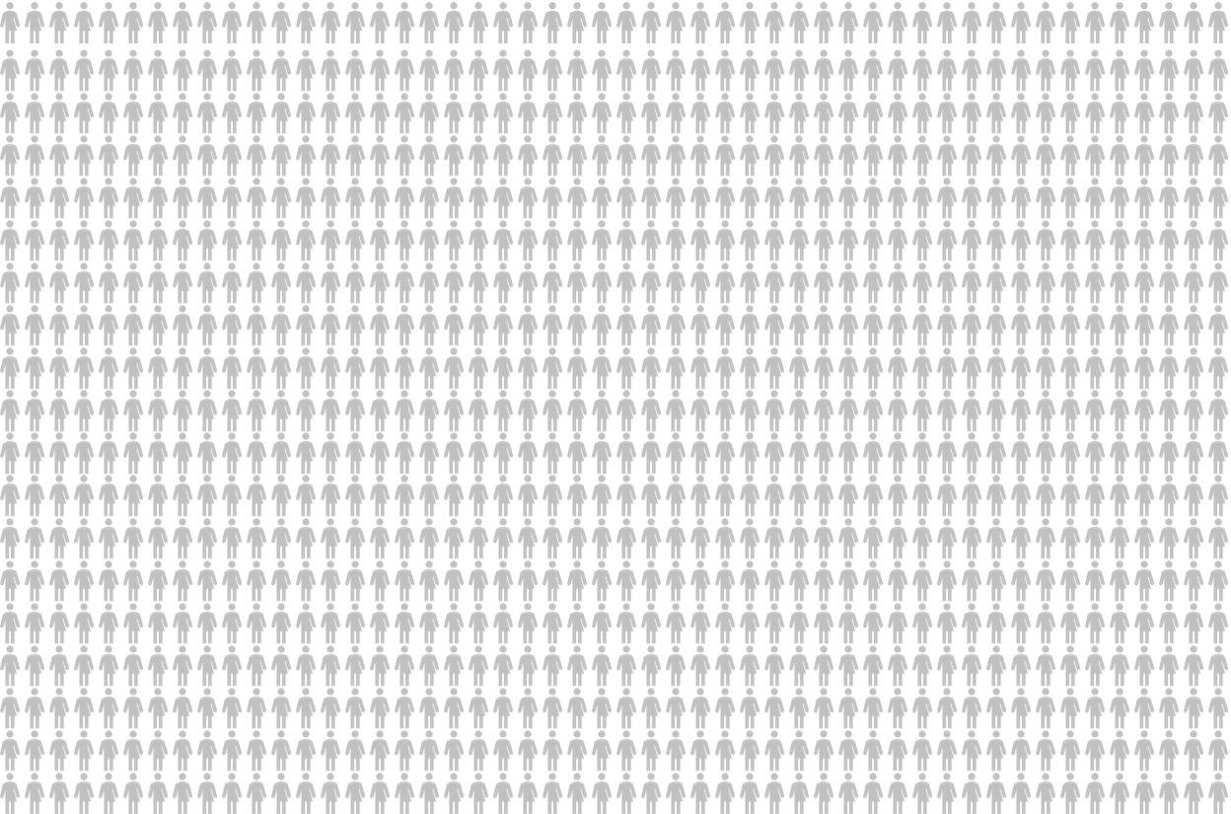
Science ITT 2017-18 to 2023-24
Target of 27,700 science trainees

Slide 34
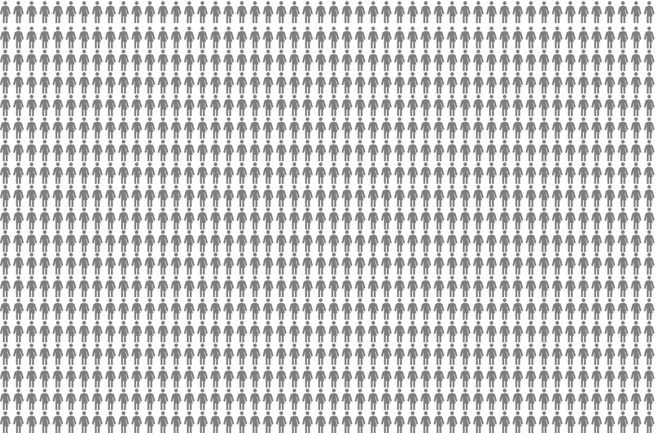
Science ITT 2017-18 to 2023-24
Target of 27,700 science trainees
19,000 trainees in DfE census (69%)

Slide 35

Science ITT 2017-18 to 2023-24
Target of 27,700 science trainees
1,800 trainees not able to receive an ITT bursary
19,000 trainees in DfE census (69%)

Slide 36
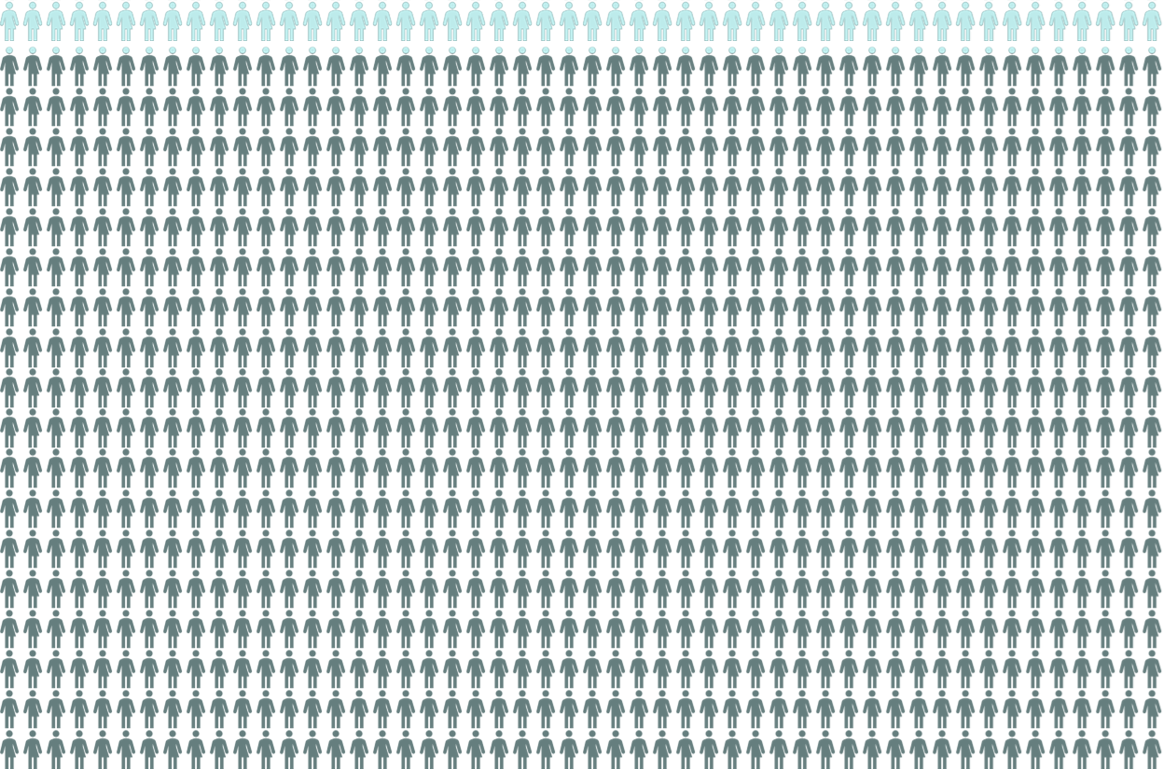
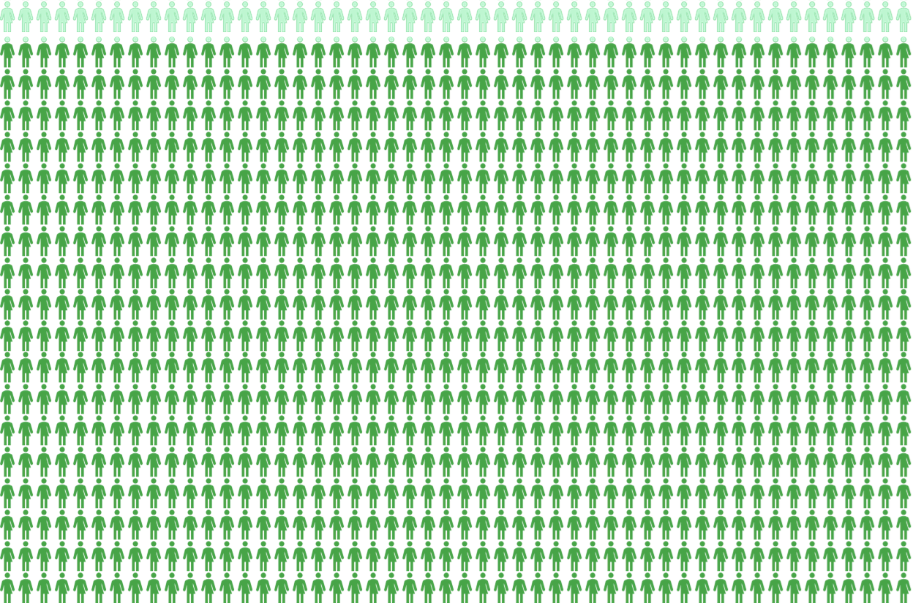
Science ITT 2017-18 to 2023-24
Target of 27,700 science trainees
1,800 trainees not able to receive an ITT bursary
19,000 trainees in DfE census (69%)
17,000 trainees complete QTS (89%)

Slide 37
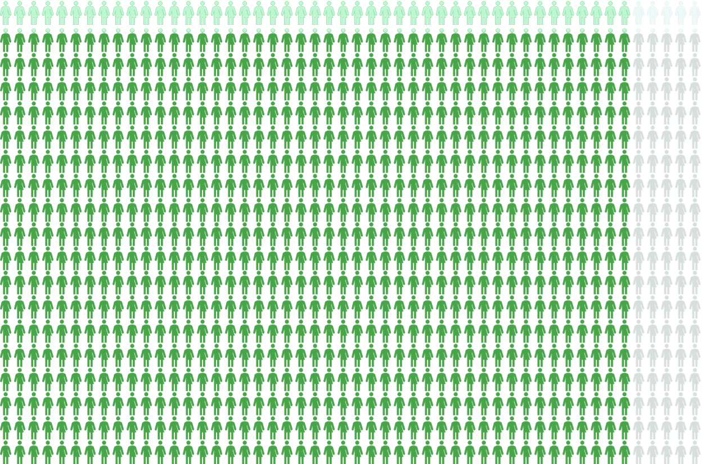

Science ITT 2017-18 to 2023-24
Target of 27,700 science trainees
1,800 trainees not able to receive an ITT bursary
19,000 trainees in DfE census (69%)
17,000 trainees complete QTS (89%)
13,100 trainees were recorded as NQE (77% of QTS)

Slide 38

Science ITT 2017-18 to 2023-24
But science bursaries have ranged from £7,000 to £28,000 with a weighted mean bursary ~ £20k
3,800 Completing with QTS but not NQE at a cost of £80 million
13,000 Science specialists funded at cost of £270 million
2,000 Starters with unknown cost
(<<£45 million)
£350-370 million spend to get 13,000 teachers equates to ~£28k per Newly Qualified Entrant

Slide 39

Recommendations to the Select Education Committee
National Foundation for educational research (NFER) data suggests that bursaries do have a positive impact on recruitment to ITE and we believe that they should be retained.
However, the extremely high bursaries of up to £27,000 might only have a limited long-term impact and create “bursary tourists”; those committed to training would still apply at lower levels of bursary
DfE restructures ITE bursaries so that all student teachers receive a standard level of financial support.
DfE fixes bursary levels for three-year periods.
https://www.nfer.ac.uk/teacher-labour-market-in-england-annual-report-2023

Slide 40
ITT Census
SKE
750
Enrolled
on to
SKE
300
40%

Slide 41
ITT Census
SKE
750
Enrolled
on to
SKE
300
~40%
85-95% of SKE students have historically not commenced ITT.

Slide 42
SKE Uptake
SKE
1200
Number of SKE students
1000
Approximate proportion of ITT trainees.
705
(39%)
800
600
Long SKE 24-28 Weeks
400
200
Short SKE 8 Weeks
0
2017-18
Years during which SKE undertaken

Slide 43
Chemistry SKE Uptake
379
(33%)
400
SKE
333
(38%)
11
350
30
275
(33%)
37
76
267
(35%)
300
240
(31%)
32
35
27
54
205
(27%)
250
73
1
12
17
35
47
9
200
40
61
13
29
28
189
14
40
26
150
164
153
149
42
145
100
110
50
0
2017-18
2018-19
2019-20
2020-21
2021-22
2022-23

Slide 44
Physics SKE Uptake
350
313
(59%)
303
(60%)
SKE
286
(50%)
300
263
(45%)
41
24
23
5
10
19
216
(35%)
250
45
43
36
43
7
26
38
55
8
200
44
8
193
16
181
20
150
32
158
161
97
(22%)
135
100
2
9
14
16
50
55
0
2017-18
2018-19
2019-20
2020-21
2021-22
2022-23

Slide 45
Biology SKE Uptake
957
(46%)
SKE
1000
807
(42%)
94
705
(39%)
93
Before recent SKE announcement, we had already predicted low SKE update – related to “a race to the bottom” given the DfE’s push towards applicants' ability to hold more offers.
800
87
165
58
70
37
166
600
125
184
77
86
400
408
421
267
(29%)
398
248
(27%)
184
(28%)
9
29
14
200
41
18
55
31
8
47
11
25
133
37
138
103
0
2017-18
2018-19
2019-20
2020-21
2021-22
2022-23

Slide 46
Selected subjects SKE Uptake
SKE
Subjects covered
Biology
Chemistry
Classics
Computing
Design & Technology
English
Geography ^{(until 2020)}
Mathematics
MFL
Physics
Religious education
6,000
4,000
2,000
0
SKE 2017-18
ITT 2018-19
SKE 2018-19
ITT 2019-20
SKE 2019-20
ITT 2020-21
SKE 2020-21
ITT 2021-22
SKE 2021-22
ITT 2022-23
SKE 2022-23
ITT 2023-24

Slide 47
Selected subjects SKE Uptake
SKE
Subjects covered
Biology
Chemistry
Classics
Computing
Design & Technology
English
Geography ^{(until 2020)}
Mathematics
MFL
Physics
Religious education
14,000
12,000
10,000
8,000
~45%
~44%
6,000
~37%
~33%
4,000
~33%
~26%
2,000
0
SKE 2017-18
ITT 2018-19
SKE 2018-19
ITT 2019-20
SKE 2019-20
ITT 2020-21
SKE 2020-21
ITT 2021-22
SKE 2021-22
ITT 2022-23
SKE 2022-23
ITT 2023-24

Slide 48
All subjects SKE Hours
Biology
Chemistry
Classics
Computing
Design & Technology
English
Geography ^{(until 2020)}
Mathematics
MFL
Physics
Religious education
SKE
Approx hours of SKE delivered
2,000,000
1,800,000
1,600,000
1,400,000
1,200,000
1,000,000
Mersey Boroughs
Vidlearn
800,000
600,000
TES
400,000
200,000
0
2017-18
2018-19
2019-20
2020-21
2021-22
2022-23

Slide 49
All subjects SKE Suppliers
Biology
Chemistry
Classics
Computing
Design & Technology
English
Geography ^{(until 2020)}
Mathematics
MFL
Physics
Religious education
SKE
60
52
50
Number SKE suppliers
40
32
30
20
10
0
2017-18
2018-19
2019-20
2020-21
2021-22
2022-23

Slide 50
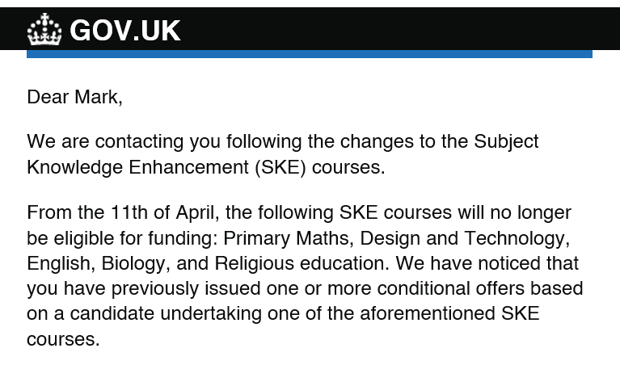
Biology
SKE
385
346
724
807
957
267
184
248
SKE
What if SKE Biology had not been available?
2000
Census
Target
1600
1200
800
400
0
2016-17
2017-18
2018/-9
2019-20
2020-21
2021-22
2022-23
2023-24
Bursary
£15-20k
£12-15k
£26k
£26k
£26k
£7k
£10k
£20k

Slide 51
Biology
If removal of support prevented 25% of SKE recipients progressing into PG ITT:
SKE
What if SKE Biology had not been available?
2000
Census
Target
1600
1200
800
400
0
2016-17
2017-18
2018-19
2019-20
2020-21
2021-22
2022-23
2023-24

Slide 52
Biology
If removal of support prevented 50% of SKE recipients progressing into PG ITT:
SKE
What if SKE Biology had not been available?
2000
Census
Target
1600
1200
800
400
0
2016-17
2017-18
2018-19
2019-20
2020-21
2021-22
2022-23
2023-24

Slide 53
Biology
If removal of support prevented 75% of SKE recipients progressing into PG ITT:
SKE
What if SKE Biology had not been available?
2000
Census
Target
1600
1200
800
400
0
2016-17
2017-18
2018-19
2019-20
2020-21
2021-22
2022-23
2023-24

Slide 54
Biology
If removal of support prevented 100% of SKE recipients progressing into PG ITT:
SKE
What if SKE Biology had not been available?
Implications:
Reduce the number of ECTs available to teach general science and increasing out-of-specialism teaching.
Viability of ITT science provision if you have fewer biologists and very small science cohorts
2000
Census
Target
1600
1200
800
400
0
2016-17
2017-18
2018-19
2019-20
2020-21
2021-22
2022-23
2023-24

Slide 55
Rethinking needed
As the DfE continues to publish separate PG ITT targets for science, it needs to show how these contribute into the supply of general science teaching at KS3
Perceived over-recruitment in Biology should not lead to bursary reduction when its impact on “general science entrants" is taken into account.
How effectively does the TWM account for the supply of general science and separate specialisms?
This is exacerbated by the failure to provide SKE to support in- and out-of-specialism teaching.

Slide 56
Recommendations to the Select Education Committee
SKE provision needs be improved.
There should be a general science SKE to equip people to train to teach in more than one science subject, which would better reflect what happens in schools. These could be delivered through (2 week) SKE/booster courses which were in the past used effectively by providers to develop key subject skills.
SKE policy be amended to allow general science SKE’s and the ability to undertake a SKE in a second science discipline and the reintroduction of short SKE booster courses

Slide 57

Any questions?
Mark Crowley
Secondary Education Course Leader
Nottingham Trent University
mark.crowley@ntu.ac.uk

