Slide 1
The elephant in the science staff room: An investigation into the maths skills and confidence of pre-service science teachers in England.
Ally Davies
Subject Advisor for Science, OCR
allyphysics@gmail.com
Caroline Neuberg
Senior Lecturer in Secondary Education, Leeds Trinity University
Liz Nourshargh
Professional Support Coach, Institute of Physics
C.Neuberg@leedstrinity.ac.uk
liz.nourshargh@iop.org

Slide 2
Overview
Maths in science: an overlooked problem?
Is there a maths issue for science teacher trainees?
Our findings
Is a change of approach needed?
Physics Teacher Educator Programme
Davies, Neuberg, Nourshargh Maths in science: an overlooked problem?

Slide 3
increased need for maths skills
The GCSE Science specification (for England) first examined in 2018 increased the Maths content to
-10% for Biology,
-20% for Chemistry,
- 30% for Physics.
Pupils' difficulty is evidenced by the scrutiny of GCSE examiner reports.
Science teachers are required to teach maths content which may include material that they have never studied themselves.
There was strong demand amongst non-Physics specialists for CPD on Maths pedagogy delivered by the IOP from March 2020 – June 2022.

Slide 4
The two research avenues
Initial Teacher Educators
Questionnaire
Demographics
Initial Teacher Trainees
Maths survey skills with confidence grid
Demographics

Slide 5
The research questions
4 - How aware are tutors of the mathematical skill levels of their science trainee teachers?
1- How common are subject-specific mathematical skills audits for science trainee teachers in England?
5 - How skilled and confident are science trainee teachers to use mathematical skills required by GCSE science qualifications?
2 - Do the demographics of science lead tutors correlate with the maths awareness and needs of their trainees?
3 - What support is offered to science trainee teachers through their Initial Teacher Training?
6 - Do the mathematical skills and confidence of science trainee teachers vary with: gender, training specialism, mathematical experience?

Slide 6
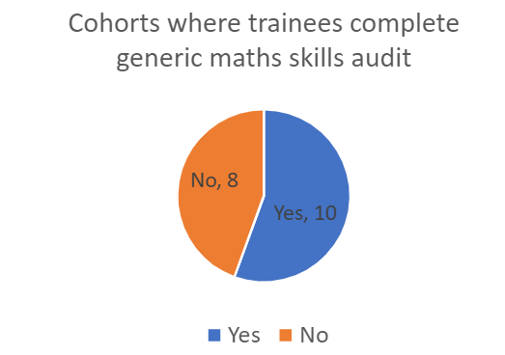
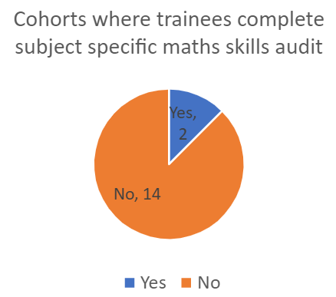
1- How common are subject-specific mathematical skills audits in English Initial Teacher Education?
Sight of 2 audits
Generic fundamental maths skills
Self-assessed

Slide 7
2- Do the demographics of science lead tutors correlate with the maths awareness and needs of their trainees?
Specialism
e.g. is the provision different depending on the specialism of the tutor?
Experience
e.g. years of training provided
Sample is too small to meaningfully disaggregate data

Slide 8
3- What support is offered to science trainee teachers through their Initial Teacher Training? teachers?
signposting support
optional online support (3rd party)
reference to ASE Language of Mathematics in Science
one day maths and science trainees together
support for e.g. A level derivations
support within appropriate contexts (e.g. magnification in context of microscopy)
school-based activity including observe maths lessons/liaise with maths department
one maths session, skills covered in other sessions
use of bar representation (see Singapore bar model)

Slide 9
Audits and maths support
Maths Pedagogical Content Knowledge
Audit
2
Assumes subject matter knowledge?
2
9
2
1
Maths Skills

Slide 10
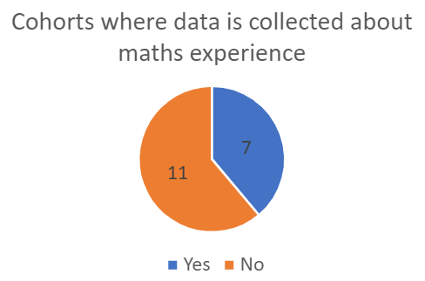
4- How aware are tutors of the mathematical skill levels of their science trainee teachers?

Slide 11
5- How skilled and confident are science trainee teachers to use mathematical skills required by GCSE science qualifications?
8 GCSE questions: no science required
Student’s answer
Competence and confidence tested
156 data set collected

Slide 12
Overview of Question Facility
Unsure and incorrect
Unsure
Confident and incorrect
Question / task
Unsure
and
correct
Answer / response
Confident
and
correct

Slide 13
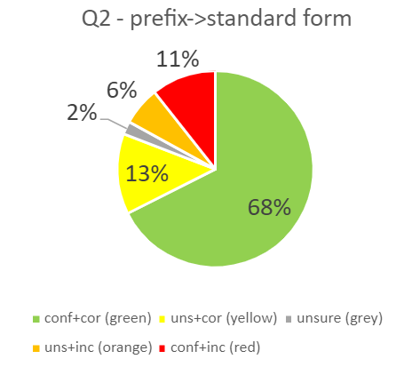
Overview of Question Facility
2. Question / task
Answer / response
Confident and correct;
Unsure and incorrect;
Unsure and correct;
Unsure;
Confident and incorrect;

Slide 14
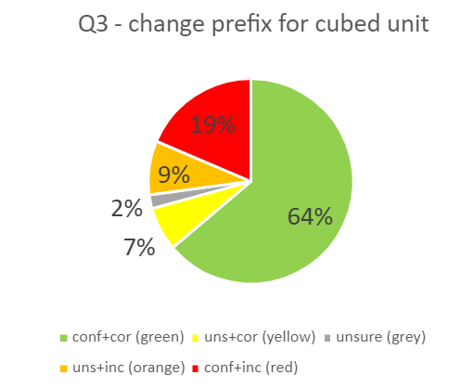
Overview of Question Facility
3. Question / task
Answer / response

Slide 15
Overview of Question Facility
Unsure and incorrect
4. Question / task
Unsure
Confident
and
incorrect
Unsure
and
correct
Answer / response
Confident
and
correct

Slide 16
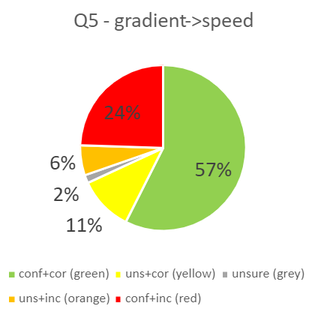
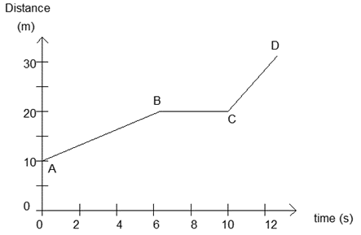
Overview of Question Facility
5. Question / task
Answer / response
Confident and correct;
Unsure and incorrect;
Unsure and correct;
Unsure;
Confident and incorrect;

Slide 17
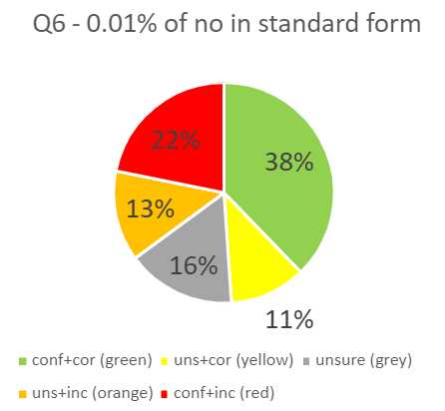
Overview of Question Facility
6. Question / task
Answer / response
Confident and correct;
Unsure and incorrect;
Unsure and correct;
Unsure;
Confident and incorrect;

Slide 18
Overview of Question Facility
7. Question / task
Confident
and
incorrect
Confident
and
correct
Answer / response
Unsure
and
incorrect
Unsure
and
correct
Unsure

Slide 19
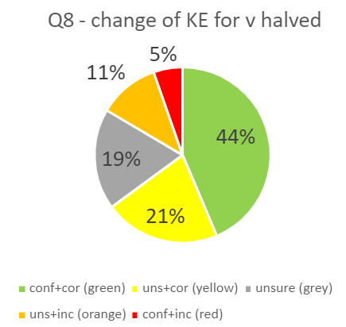
Overview of Question Facility
8. Question / task
Answer / response
Confident and correct;
Unsure and incorrect;
Unsure and correct;
Unsure;
Confident and incorrect;

Slide 20
Overview of Question Facility
7. Question / task
Confident
and
incorrect
Confident
and
correct
Answer / response
Unsure
and
incorrect
Unsure
and
correct
Unsure

Slide 21
Overview of Question responses
Percentage of responses
Correct (confident and unsure) ;
Confident and correct;
Hubris: confident and incorrect;

Slide 22
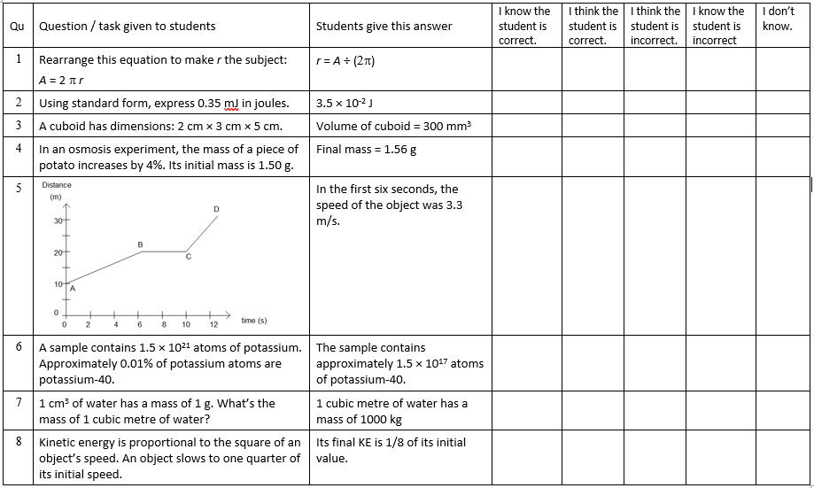
8 correct and confident answers
7 incorrect and 8 unconfident answers

Slide 23
Plot of correct and confident
100%
75%
50%
Responses
Where on this graph would you like future science teachers to be?
25%
0%
8
13.5% of the trainees are confident and correct on all
8 maths GCSE questions.
6
4
73% were not confident in one or more responses.
2
0
0 2 4 6 8
correct

Slide 24
Further analysis: Scoring of responses
Response was | Score for competence+confidence | Score for competence
Confident, correct | 2 | 2
Unconfident, correct | 1 | 2
Unsure | 0 | 0
Unconfident, incorrect | -1 | -2
Confident, incorrect | -2 | -2

Slide 25
6- Do the mathematical skills and confidence of science trainee teachers vary with: gender, TRAINING SPECIALISM, mathematical experience?
Competence score
Competence + Confidence score

Slide 26
Conclusions from the trainee survey
5 - How skilled and confident are science trainee teachers to use mathematical skills required by GCSE science qualifications?
6 - Do the mathematical skills and confidence of science trainee teachers vary with: gender, training specialism mathematical experience?
66% showed hubris in one or more responses.
73% were unconfident in one or more responses.
27% were confident in all 8 responses, but of these, half were incorrect on one or more, whilst the other half were confident and correct on all 8.
Variation between groups is small
No subgroup achieved the confidence and competence level expected in a secondary science classroom
Low confidence could be problematic: Student questions could cause stress / anxiety

Slide 27
In conclusion…
A more worrying landscape than initially thought
Source of anxiety for teachers compounded with out of subject specialism could be motivating factor in teachers leaving the profession
An implication on teacher’s retention

Slide 28
How to address this problem
Address this through several routes
ITE centres
Gather data on highest level of qualification of trainee science teachers
Subject specific maths skills audit
Provide access to all trainees to maths provision
Include maths pedagogy within PGCE Science courses
In service teachers
Subject specific maths skills audit
CPD provision eg The Ogden Trust SKPT, Isaac Physics
Funding for cover
Not a two-hour fix – needs long term CPD
Policy makers
In advance of curriculum reform, consider skills and experience of current workforce (and any support that may be needed)
Mandate subject specific maths skills audit for ITE
Mandate inclusion of subject specific maths skills and pedagogy

Slide 29
How to address this problem
Address this through several routes
ITE centres
Subject specific maths skills audit
Provide access to all trainees to maths provision
Include maths pedagogy within PGCE Science courses?
In service teachers
Subject specific maths skills audit
CPD provision eg The Ogden Trust SKPT, Isaac Physics
Funding for cover
Not a two-hour fix – needs long term CPD
Policy makers
In advance of curriculum reform, consider skills and experience of current workforce (and any support that may be needed)
Mandate subject specific maths skills audit for ITE
Mandate inclusion of subject specific maths skills and pedagogy

Slide 30
Thanks To
Institute of Physics for bringing us together via the PTE programme
Leeds Trinity University for supporting the project
ITE tutors and their trainees for completing our survey
Davies, Neuberg, Nourshargh

Slide 31
Questions?
Davies, Neuberg, Nourshargh

