Slide 1
Notes:
Hi everyone, for those that don’t know me, I’m Nicole and my colleague Ian and I are responsible for promoting teaching to physicists and engineers.
I’m aware that you’ve heard much of this before so I’m going to give a very brief refresher about some of the things we’re working on at the moment, before kindly asking for some feedback from you about what more we could be doing to support you in your recruitment of trainee physics teachers.

Slide 2
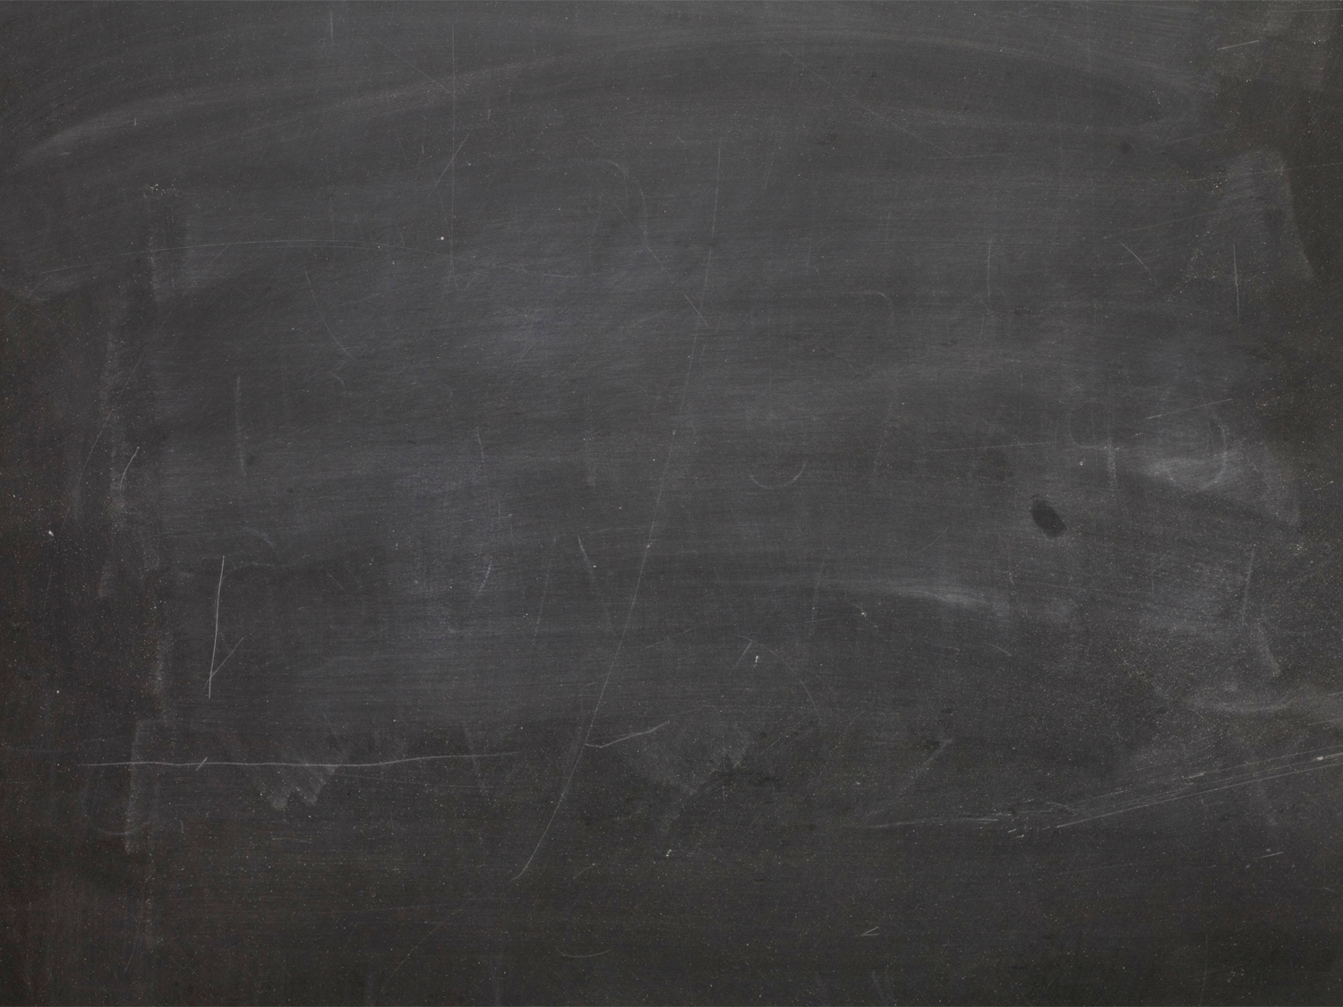
Our Focus
Teacher Training Scholarships
Increasing awareness with engineers
Campus events
School Experience Programme
Notes:
This year, successful scholars are awarded £28,000 tax-free funding, as well as a package of support that includes IOP membership, and invitation to our exclusive celebration events, and also events to professional development events we call super trips and masterclasses.
Please, please do tell your applicants and teacher trainees starting in September about the scholarship – they could gain an extra £2,000 and additional support from us throughout their training year.
Even if they’re not successful at scholarship, they can use our many teaching resources, join our TalkPhysics community and attend events throughout the year, so we would love to hear from them.

Slide 3
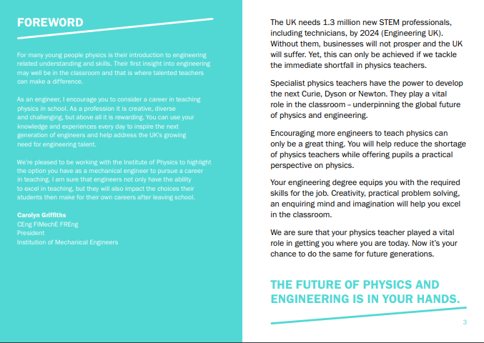
Our Focus
Teacher Training Scholarships
Increasing awareness with engineers
Campus events
School Experience Programme
Notes:
Successful scholars who have a degree in mechanical engineering will also be awarded membership of the IMechE, which leads us into increasing awareness with engineers. You may have seen previously our engineering brochures, these now include a foreword from the president of the IMechE. We hope this increases relevance to engineering graduates looking into teaching. This year we also attended more STEM fairs in the first term than in previous years to reach both physics and engineering undergraduates.

Slide 4
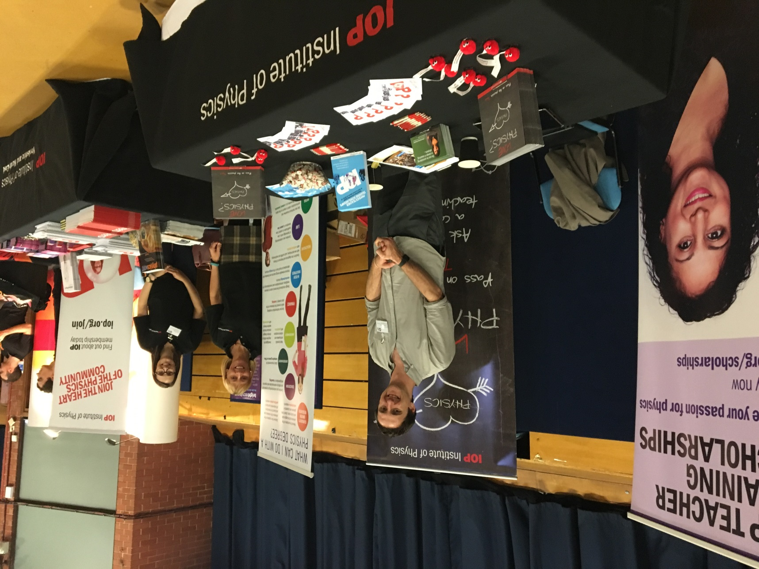
Our Focus
Teacher Training Scholarships
Increasing awareness with engineers
Campus events
School Experience Programme
Notes:
We have continued to bring our marketing materials to university campus’. We attend a combination of STEM and Physics Careers fairs, as well as hosting out own Café Physics and Insight into Teaching drop in events for students. Ian and I have visited 23 campus’ so far this year, some more than once to visit the physics and engineering departments separately.
We employ a student ambassador on campus to help promote our event to undergraduate and postgraduate students.
We also attend all of the larger TTT events organised by the DfE and this year we’re also hosting more webinars to give us the opportunity to speak with those who are unable to attend an event in person.
So far we’ve met over 280 prospective teachers that have signed up, and many others too.
If we haven’t been to your university yet this year, and you would like us to visit, please let us know. We welcome any contacts you can put us in touch with in physics, outreach and careers departments to help us to get the message out there.

Slide 5
Our Focus
“It was a wonderful day which helped me realize how much I would enjoy being a science teacher”
“All of the reservations & worries I had about becoming a secondary school teacher have been addressed & eased thanks to this experience. I am now more determined than ever to continue with my plans of becoming a physics teacher.”
Teacher Training Scholarships
Increasing awareness with engineers
Campus events
School Experience Programme
Notes:
We’re continuing to run our school experience programme to support people to gain the experience they need to apply for ITT and we’ve received some good feedback. We’re always looking to expand our network of schools so please do let us know if you or any of the schools you work with are able to provide school experience to those registering through the IOP.

Slide 6
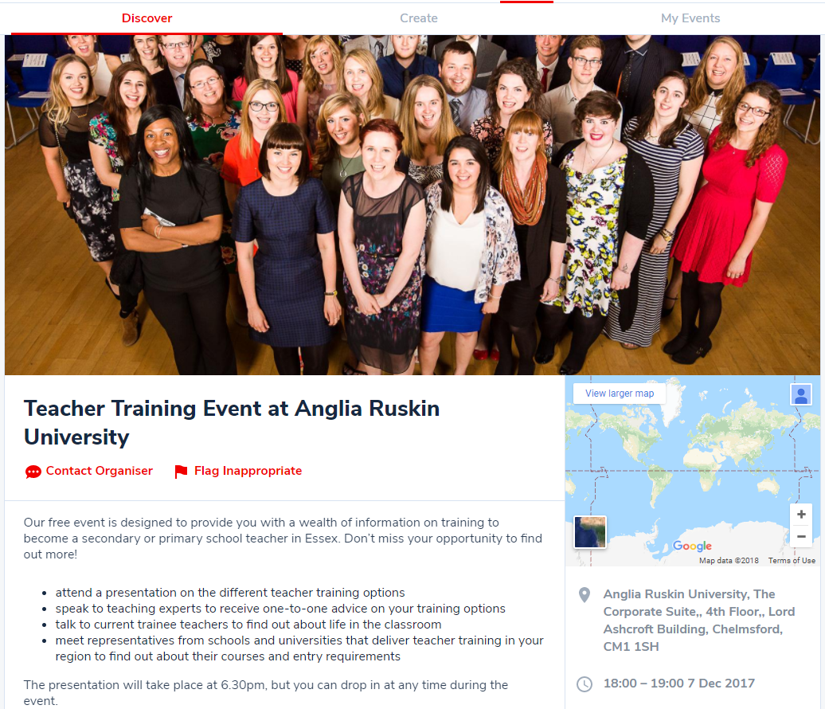
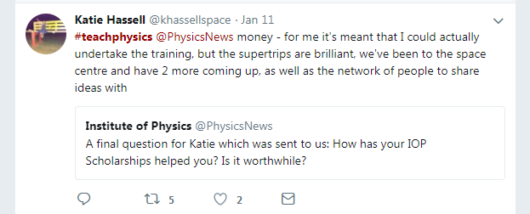
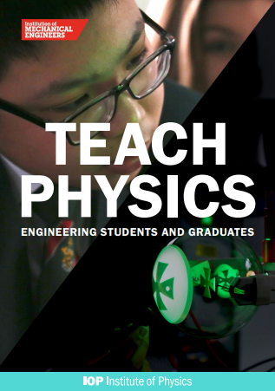
Your feedback and ideas
Our marketing
events.iop.org
iop.org/education
teach@iop.org
Notes:
Some of the things we’re doing to promote teaching and the scholarship include:
I wanted to let you know that in the last year, we’ve relaunched a new IOP events service and we invite you to promote your events to recruit physics teachers on there! We share this list of events with prospective teachers we have on our database and it’s used by physicists, so it’s a great way to gain exposure to those who are already thinking about teaching, and those who might not yet have considered it as a career. We’ve had several schools and universities already list their events. If you’d like to do so, you can do this directly, or get in touch with us at teach@iop.org
We also promote teaching on the IOP website. There is lots of information for prospective teachers, as well as teacher training providers on iop.org/education. We also have the IOP blog where we share the stories of our scholars, and would be happy to share blog pieces from your physics teacher trainees about their experiences of teacher training at your institution.
We have produced brochures, some of which you see on your tables. We circulate these by postal mailing to universities and schools, and also take them out to our events to give to students. It would be great to get your feedback on these, do you receive the right amount, and if you think there is more we can do. We’ll come to that in a moment.
We use advertising channels to reach beyond our IOP audience.
We use social media and recently held our first ‘tweet up’ with a physics teacher – if you’re looking to do something similar, let us know and we can get involved where appropriate.
And finally, we would love to hear from you.
We have a few minutes now for us to discuss, but if you would prefer to take a look and leave some feedback, on your tables, there are some copies of our marketing materials and some feedback forms.
So I was wondering if anyone has any questions or comments about what I’ve just said?
Does any one have any questions about how we can better support you in your marketing to recruit?
We’re aware that 47% of physics ITT take an SKE course – we work with physicists and engineers – do you see a high number of applications from any other degree courses that we should be aware of?

Slide 7
Thank you!
Get in touch: nicole.averiss@iop.og
Notes:
If you have any questions please let me know.
I wanted to let you know that in the last year, we’ve relaunched a new IOP events service and we invite you to promote your events to recruit physics teachers on there! We share this list of events with prospective teachers we have on our database and it’s used by physicists, so it’s a great way to gain exposure to those who are already thinking about teaching, and those who might not yet have considered it as a career.
We also have loads of information on our website – including information about marketing your courses, so I recommend that you visit iop.org/education for more info.
All our brochures have been updated for this year, for physicists, engineers and school experience. We hope you received some of these in the post towards the end of last year. If you didn’t, and want to receive some, please send an email to me, or to teach@iop.org. There are some copies on your tables too if you’re not familiar with them.

